Slide 1
Customizing Premiere Pro
Objective: 3.03
Navigate, organize, and customize the workspace

Slide 2
Customizing Workspaces
Workspaces are preset arrangements of panels, organized to make particular tasks easier. There’s one for editing, another for working on audio, and another for making color adjustments, for example.
Every panel is accessible from the Window menu, but workspaces are a quicker way to access several panels and have them laid out exactly as you need them, in a single step.
Before you begin, make sure you’re using the default Editing workspace by choosing the Editing workspace option in the Workspaces panel at the top of the screen.

Slide 3
If Workspaces are not visible
If the Workspaces panel is not visible, choose Window > Workspaces > then choose the workspace you are looking for.

Slide 4
Adjusting Premiere Pro
In addition to choosing between the default workspaces, you can adjust the position and location of panels to create a workspace that works best for you. You can create multiple workspaces for different tasks
As you change the size of a frame, other frames change size to compensate.
Every panel within a frame is accessible by clicking its name.
You can change the font size in the Project panel by choosing Font Size from the panel menu and then choosing Small, Medium (Default), Large, or Extra Large from the submenu.

Slide 5
ADJUST WORKSPACES
It’s easy to adjust the size of panels, undock them, and even close them.
Place the mouse pointer on the vertical or horizontal divider between panels and then drag to resize them.

Slide 6
DOCK and UNDOCK PANELS
When you drag a panel, Premiere Pro displays a drop zone. You drag by clicking the panel tab (the name of the panel) and hold and drag.
Drop-zones provide visual cues as you drag panels to rearrange them within the docked panel layout.
You can drag a panel out of a frame to become a separate floating panel or choose Undock Panel from the panel menu.

Slide 7
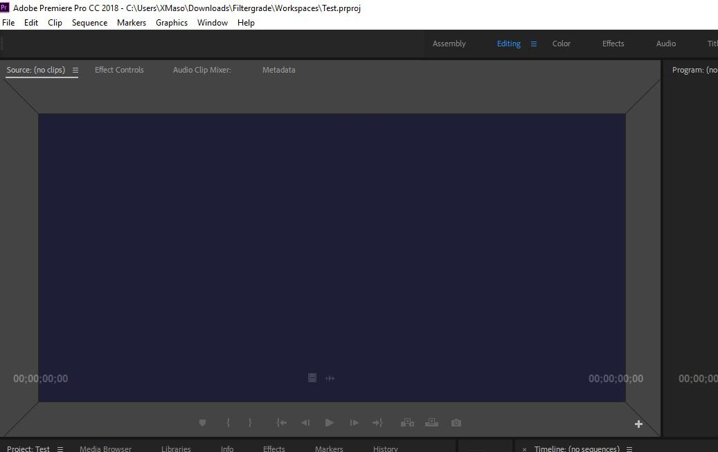
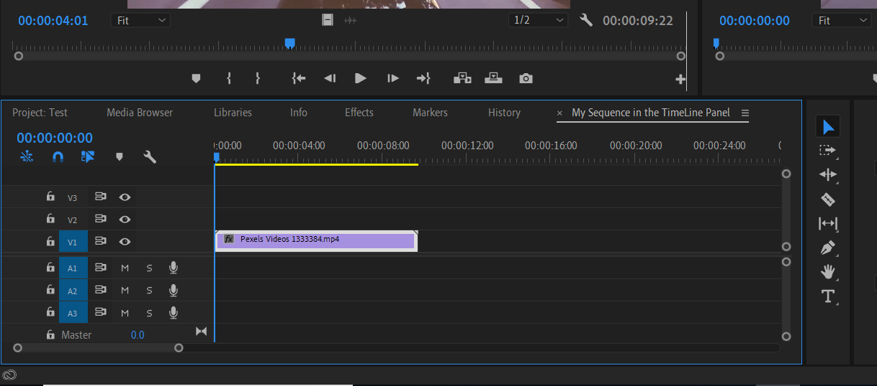
Multiple Options to Dock
There are multiple ways to dock your panels. You can have your panels either above or below or on the side of an existing panel.
When you hover over a center of a drop-zone this groups (nests) the panel that you are moving with the existing panel group, creating a new tab

Slide 8
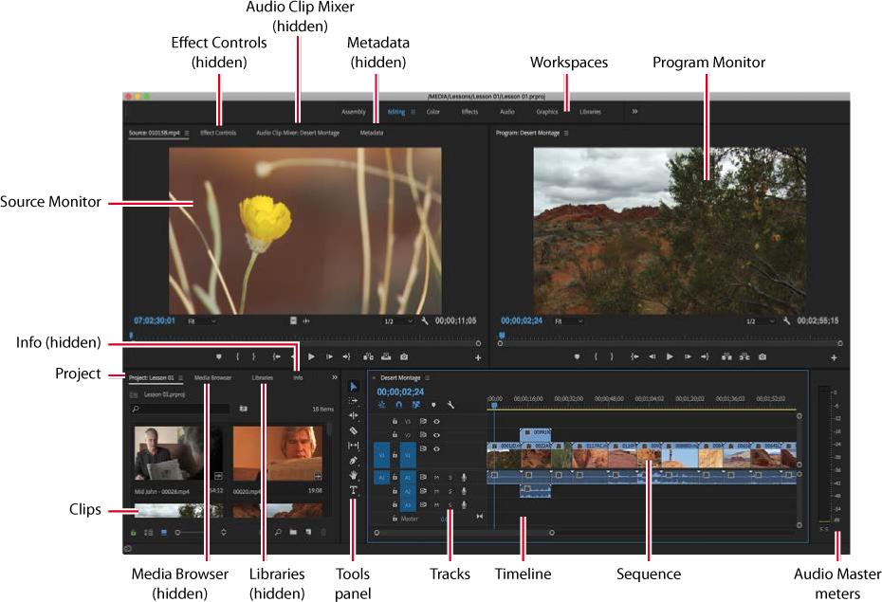
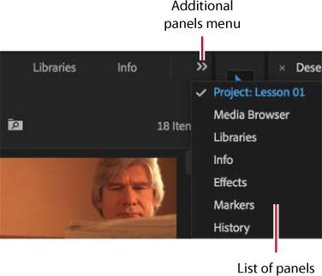
When many panels are combined, you may not be able to see all their names. If this is the case, a menu of additional panels is displayed. Click this menu to access a hidden panel in a frame.
You can display any panel by choosing it from the Window menu, so if you can’t locate a panel, just look there.

Slide 9
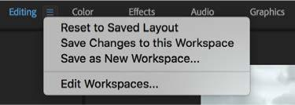
RESET WORKSPACES
If you ever mess up your workspace a lot and want to go back to the original settings, you can easily to do in the Window menu.
Window > Workspace > Reset To Saved Layout
Also click the small panel menu icon next to the Editing option on the Workspaces panel and choose Reset To Saved Layout.

Slide 10
SAVE CUSTOM WORKSPACES
Once you have configured your panels, you can save a custom workspace by choosing Window > Workspace > New Workspace. Name the new workspace and click OK. Or Save as New Workspace in the workspace menu

Slide 11
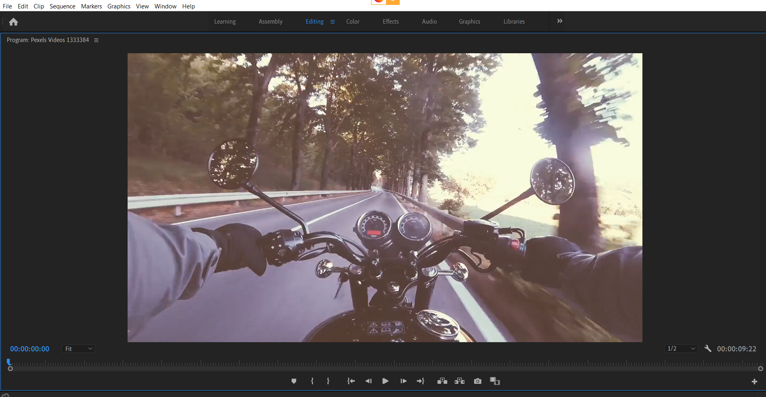
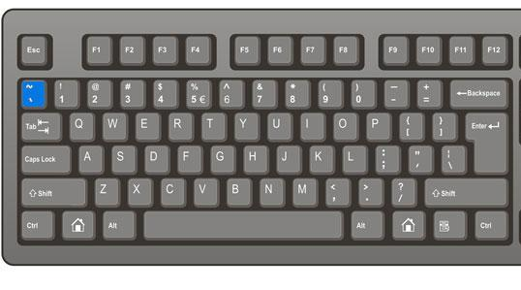
Tilde Key
The tilde (~) key acts as a minimize/maximize toggle for whichever panel is currently active.

Slide 12
Application Preferences
You can change every aspect of your program and interface through Application Preferences.
To access the Application Preferences, you must go to Edit > Preferences and then choose what you want to change.
A few examples are:
You can change the Brightness of your interface through the Appearance tab
You can change your microphone and headphone input and output under Audio Hardware (we used this when we did voiceovers)
You can change the length of transitions and still images under the Timeline tab

Slide 13
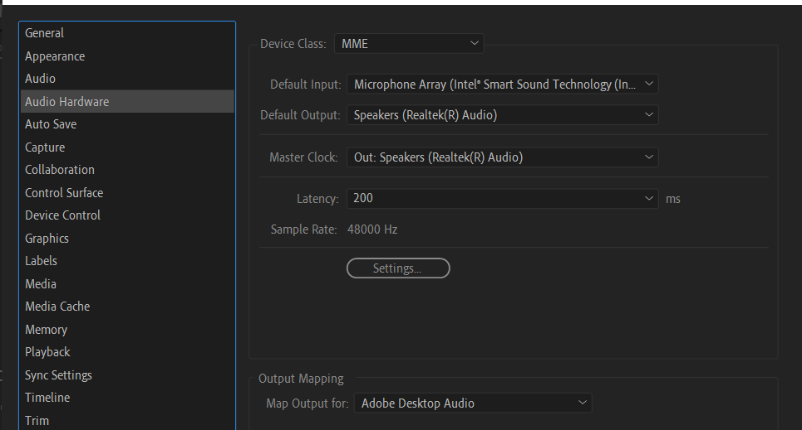
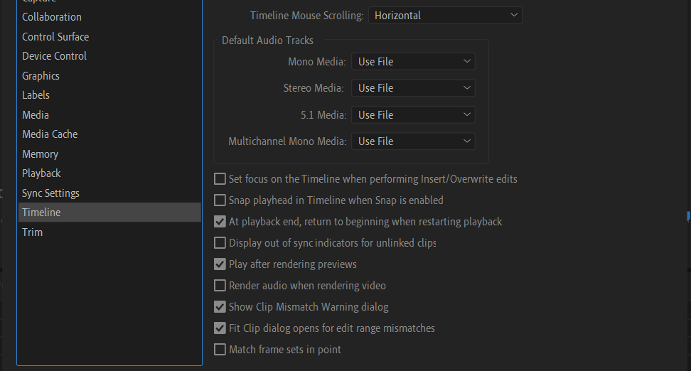
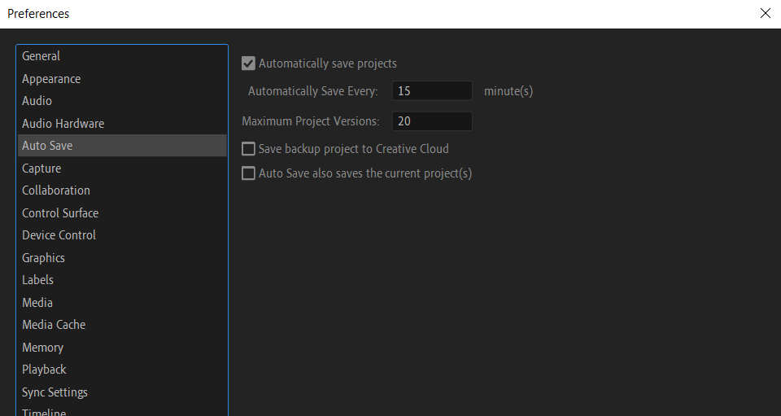
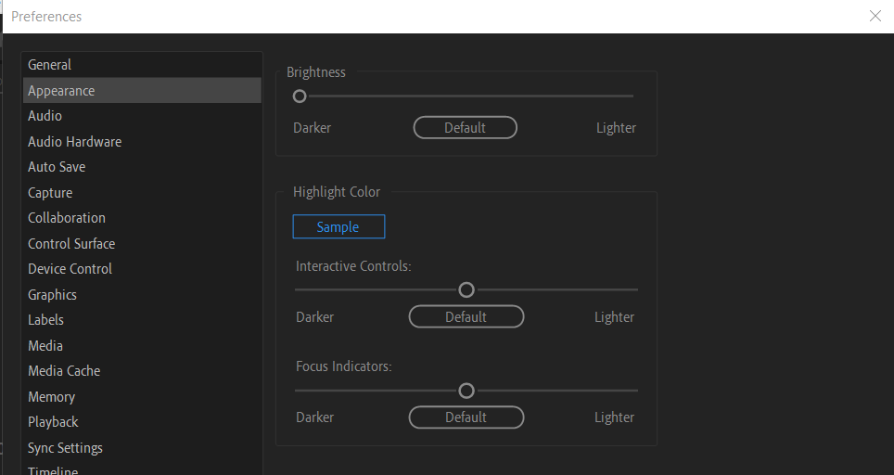

Slide 14
Auto Save
Imagine if you had worked for hours and then there was a power outage. If you hadn’t saved recently, you’d have lost a lot of work.
Under the Auto Save Preference, you can decide how often you would like Premiere Pro to save an automated backup of your project and how many versions you would like to keep in total.
This function is also nice when you want to return to an earlier version of your project because you accidently deleted something that you can undo.
Your backups are saved in the Adobe Premiere Pro Auto-Save Folder that is created by the application and stored in the same location as your original project file.
There’s also an option to save a backup project to Creative Cloud. If you suffer a total system failure while working, you can log in to any Premiere Pro editing system with your Adobe ID to access the backup project file and quickly carry on working.

Slide 15
Moving, backing up, and syncing user settings
Premiere Pro includes the option to share your user preferences between multiple computers: When installing Premiere Pro, you will have entered your Adobe ID to confirm your software license. You can use the same ID to store your user preferences in Creative Cloud, allowing you to synchronize and update them from any installation of Premiere Pro.
You can sync your preferences on the Start screen by choosing Sync Settings. You can also sync your preferences while working with Premiere Pro by choosing File > Sync Settings > Sync Settings Now (Windows) or Premiere Pro CC > Sync Settings > Sync Settings Now (macOS).

