Slide 1
Documentaries
Objective: 2.02
Demonstrate knowledge of basic principles and best practices employed in the digital video industry.

Slide 2
News and Documentary
a nonfictional motion picture intended to document some aspect of reality, primarily for the purposes of instruction, education, or maintaining a historical record.

Slide 3
Documentary History Highlights
The very first films (pre-1900’s) were called "actuality films" - short snippets of real "actual" events
Basically, the first movies ever made were documentaries, or newsreels.
Check out one of the very first videos on the next slide

Slide 4
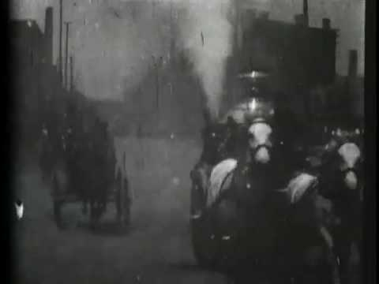

Slide 5
Documentary History Highlights
1920’s Russia – Some say the true spirit of the documentary starts with a young poet and film editor named Dziga Vertov.
He and his group created a series of educational newsreels called the Kino-Eye (literally, "cinema truth") during the Russian Revolution.
Nanook of the North - by American filmmaker, Robert Flaherty (1922) - Considered the first "original" documentary, this film profiles the lives of a real Inuit family.

Slide 6
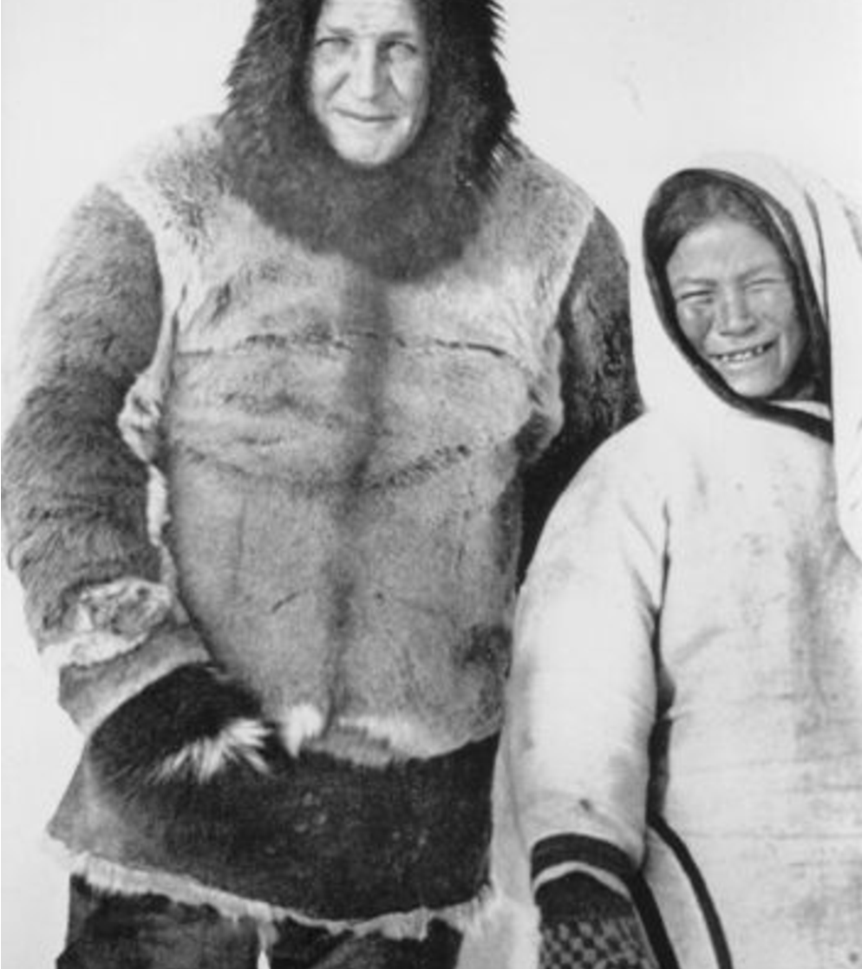
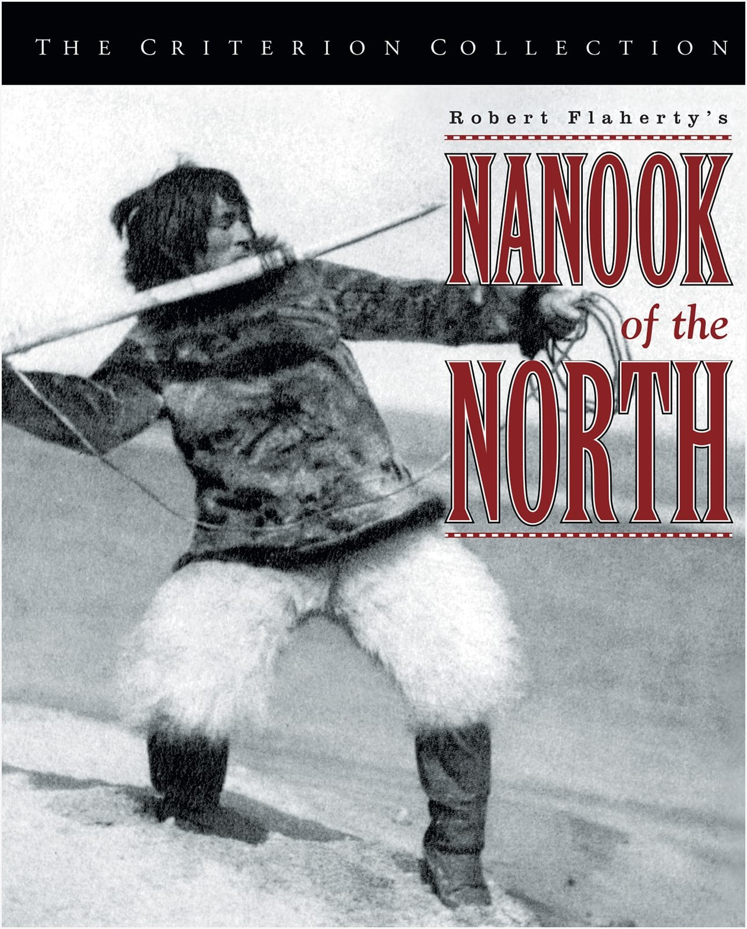

Slide 7
Documentary History Highlights
1926 first time we see the term "documentary" used to describe a non-fiction film.
1930’s & 1940’s – the documentary becomes a valuable propaganda tool for governments such as Nazi Germany, America and Britain, especially during WWII.

Slide 8
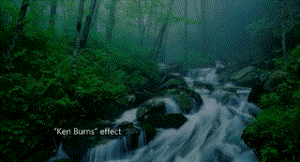
Documentary History Highlights
1960’s – 1990’s - Television becomes an important outlet for documentary filmmaking, putting more of an emphasis on journalistic and educational programs (i.e. Ken Burns’s Civil Warseries, 1990).

Slide 9
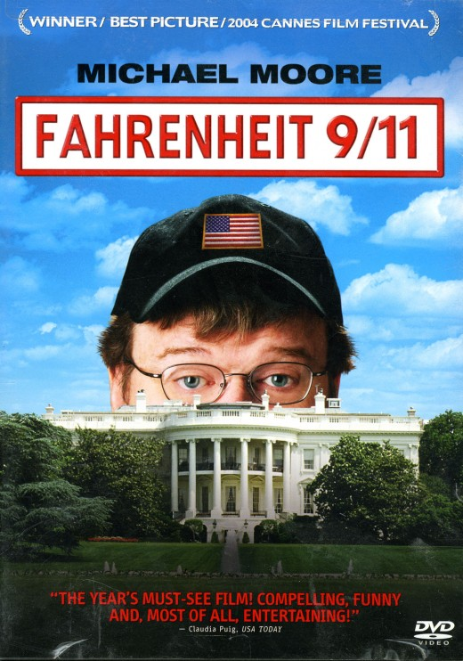
Some Documentaries you have either heard of or seen

Slide 10
WHAT MAKES A GOOD DOCUMENTARY?

Slide 11
Good Documentaries
#1 is the story line.
2nd is an unbiased approach.
Raises more questions than answers.
People think that it should have an ultimate explanation of something. FALSE - The viewer serves as the juror.
Should always tell the truth even if people do not
The soundtrack or music is very important. It sets the tone.

Slide 12
HOW TO MAKE A DOCUMENTARY
4 Components

Slide 13
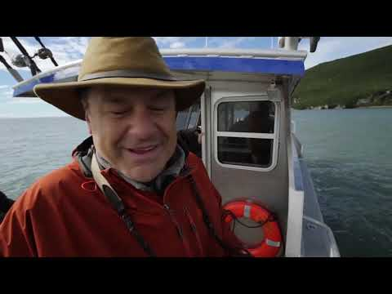
The Interview
Usually, a medium shot of your subject, where you are standing off screen near the camera and they are talking to you. Your subject should have a graphic introducing them the first time you see them in your video.
Use the interview to lay down the narration of your documentary. String out your story from interview to interview with narration and broll thrown in to help it flow smoothly.

Slide 14
Effective Questions vs Leading Questions
Effective questions are known as open ended questions. They are designed to help move a conversation between the interviewer and the subject. They encourage a conversations about experiences, emotions, attitudes or opinions. Effective questions are not closed-ended questions. Closed ended questions are yes or no type questions.
Leading Questions are questions that prompts or encourages a desired answer.
Example:
Effective Question – Where were you on March 13th?
Leading Question – On March 13th, is it true that you were in school and hung out with your friends?

Slide 16
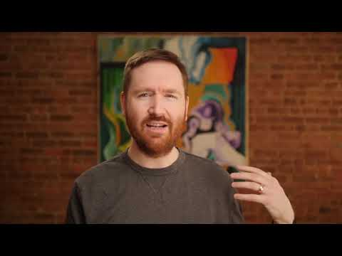
Narration – Voice Over
Your voiceover should only be used to give information that wasn’t provided in interviews.
VO’s should help bridge the gap to smoothly flow from one interview to the next interview.
VO’s can also be used to open and close your documentary

Slide 17
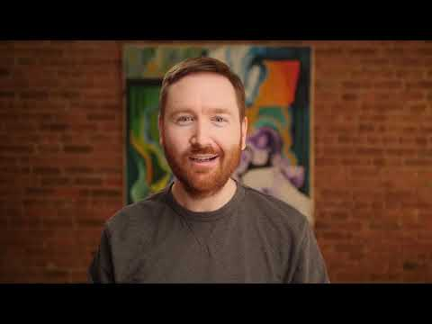
Broll
Overshooting is key!
Make sure to get enough Broll, even if you think you have enough GET MORE. You never know what you’ll need or like until you start editing and that extra shot might be the best for your video.

Slide 18
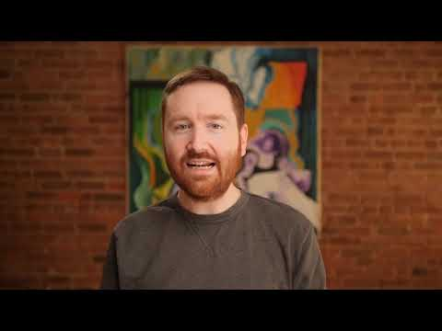
Audio – Music and Nat Sound
Throwing in Natural Sound (nat sound) will help give authenticity to your video. You can use it in your B Roll to give a break or breath in a thought or idea.
Your music should also help your video flow from scene to scene.

Slide 19
How you edit your footage between Interviews
Review of Types of Cuts

Slide 20
Standard Cut
The most used cut out there
Placing a clip next to another clip
This cut is great when you’re trying to keep things simple

Slide 21
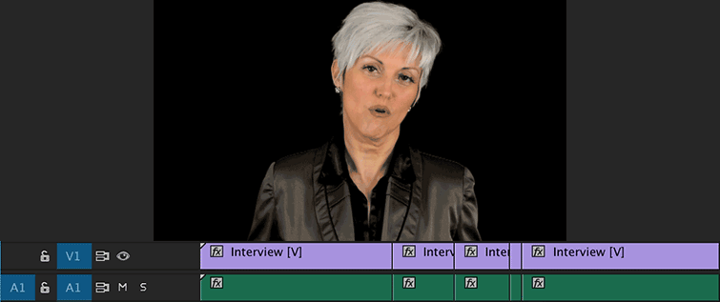
Jump cut
Abrupt switch from one scene to another which may be used deliberately to make a dramatic point or can look sloppy if in an interview setting

Slide 22
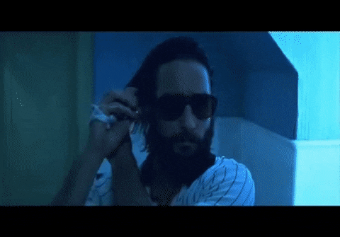

Slide 23
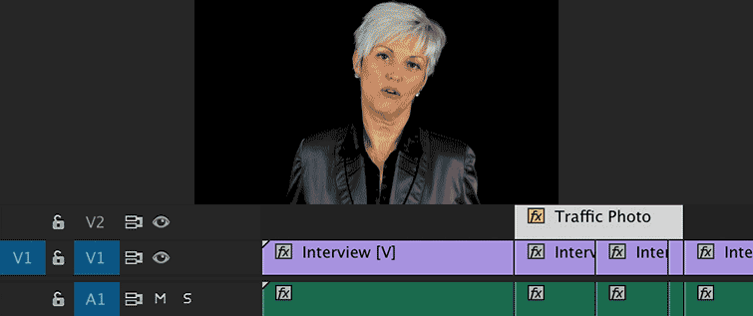
Cutaways
A cutaway shot is a shot that "cuts away" from the main action to any shot that adds visual information, and then returns to the original shot with new meaning.

Slide 24
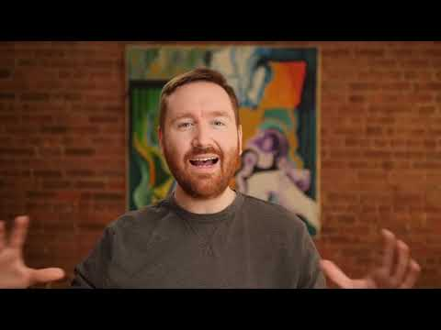

Slide 25
Don’t forget about the J-CUT/L-CUT
A J-Cut is when you hear audio from a shot and then see the video. You make the letter J visually in the timeline.
An L-Cut is when you cut to different video but the audio from that previous shot remains.
Notes:
https://www.premiumbeat.com/blog/8-essential-cuts-every-editor-should-know/

Slide 26
Making your Mini-documentary
Why would this topic make a good documentary?
What questions would you like this documentary to answer?
Who would you interview for this documentary?
What do you want the documentary to be about?

Slide 27
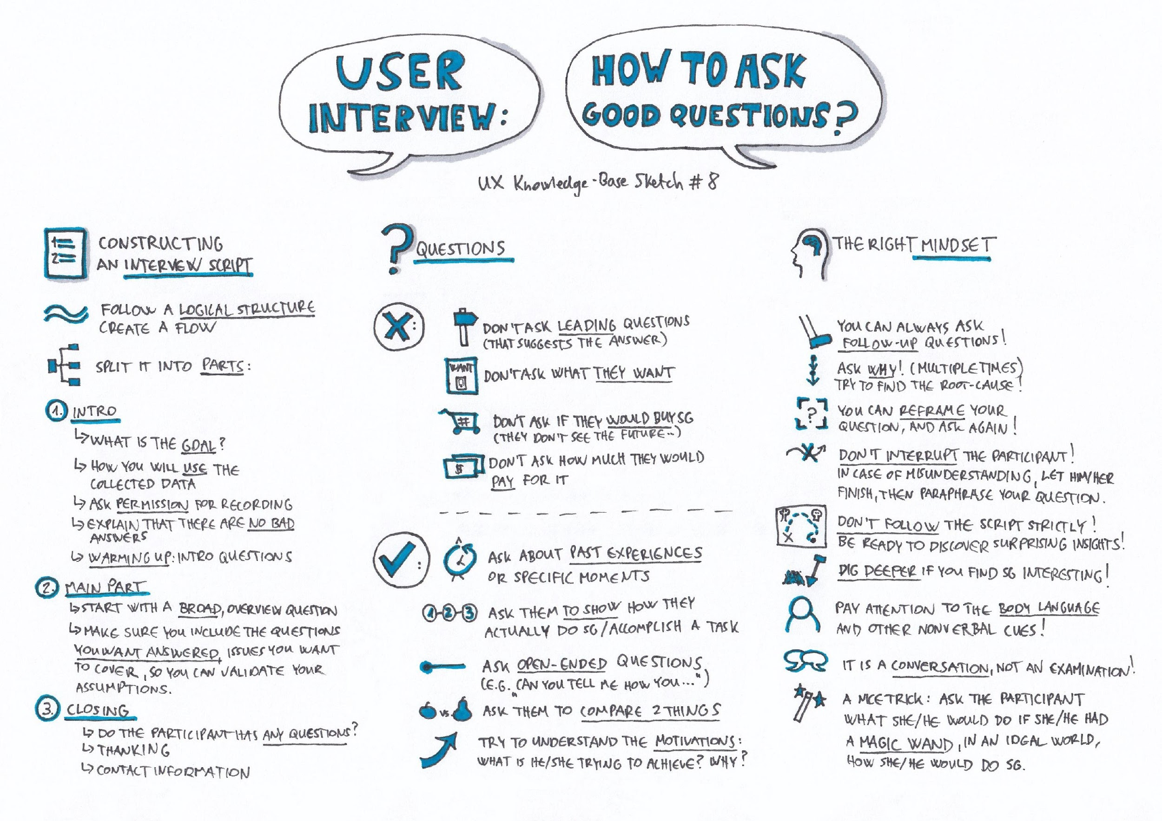

Slide 28
Project Requirements
Length should be 3–5 minutes and interview at least 1 person.
Use effects, graphics, color, all aspects you have learned in class
Can include still images that incorporate transitions and effects.
Must use a storyboard or shot list and scripted questions and VO.

Slide 29
Project Rubric
Score | Description
100 | Cut together a mini-documentary that has a clear theme and goal about a specific topic. Shots are in focus; story is strung together to have a clear thought-process and audio is balanced. Color effects, audio-editing, and musical score added to enhance video. Graphics are used correctly to name people and have thought put into them. Title and credits are used. Storyboard/shot list and script are provided. Everyone in group is listed – presentation is flawless. Answers all Q&A questions.
80 | Cut together a mini-documentary that has a clear theme and goal about a specific topic. Shots are in focus; story is strung together to have a clear thought-process and audio is balanced. Musical score added to enhance video. Graphics are used correctly to name people and have thought put into them. Title and credits are added. Storyboard/shot list and script is provided. Everyone in group is listed – presentation is good. Answers almost all Q&A questions.
60 | Cut together a mini-documentary that has a clear theme and goal about a specific topic. Shots are in focus and graphics are used correctly to name people. Story is strung together to have a clear thought-process and music is added to enhance video. Title and credits are added. Storyboard/shot list and script are provided but missing key elements. Everyone in group is listed – presentation is not effective. Answers some Q&A.
40 | Cut together a mini-documentary. Graphics are used correctly to name people. Story is strung together to have a clear thought-process and music is added to enhance video. There is a title. Storyboard/shot list and script are not provided – no presentation/presentation not effective at all. Doesn’t answer Q&A.
20 | Cut together a mini-documentary. Graphics are used correctly to name people. Story is strung together to have a clear thought-process and music is added to enhance video. Storyboard/shot list and script are not provided – no presentation. Doesn’t answer Q&A.

