Slide 1
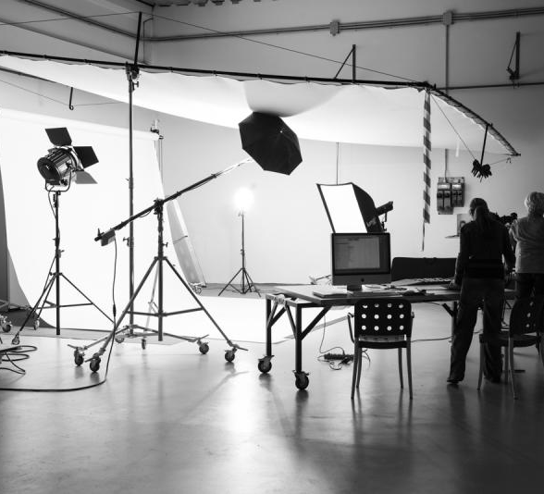
Hardware: Lights, Cables & Mics
Objective: 2.02

Slide 2
Lighting

Slide 3
Common Lighting Issues
Think back to when we talked about aperture earlier. These issues I have seen too many times in House Hunters and other professionally shot shows. The iris controls the aperture which lets in the appropriate amount of lighting

Slide 4
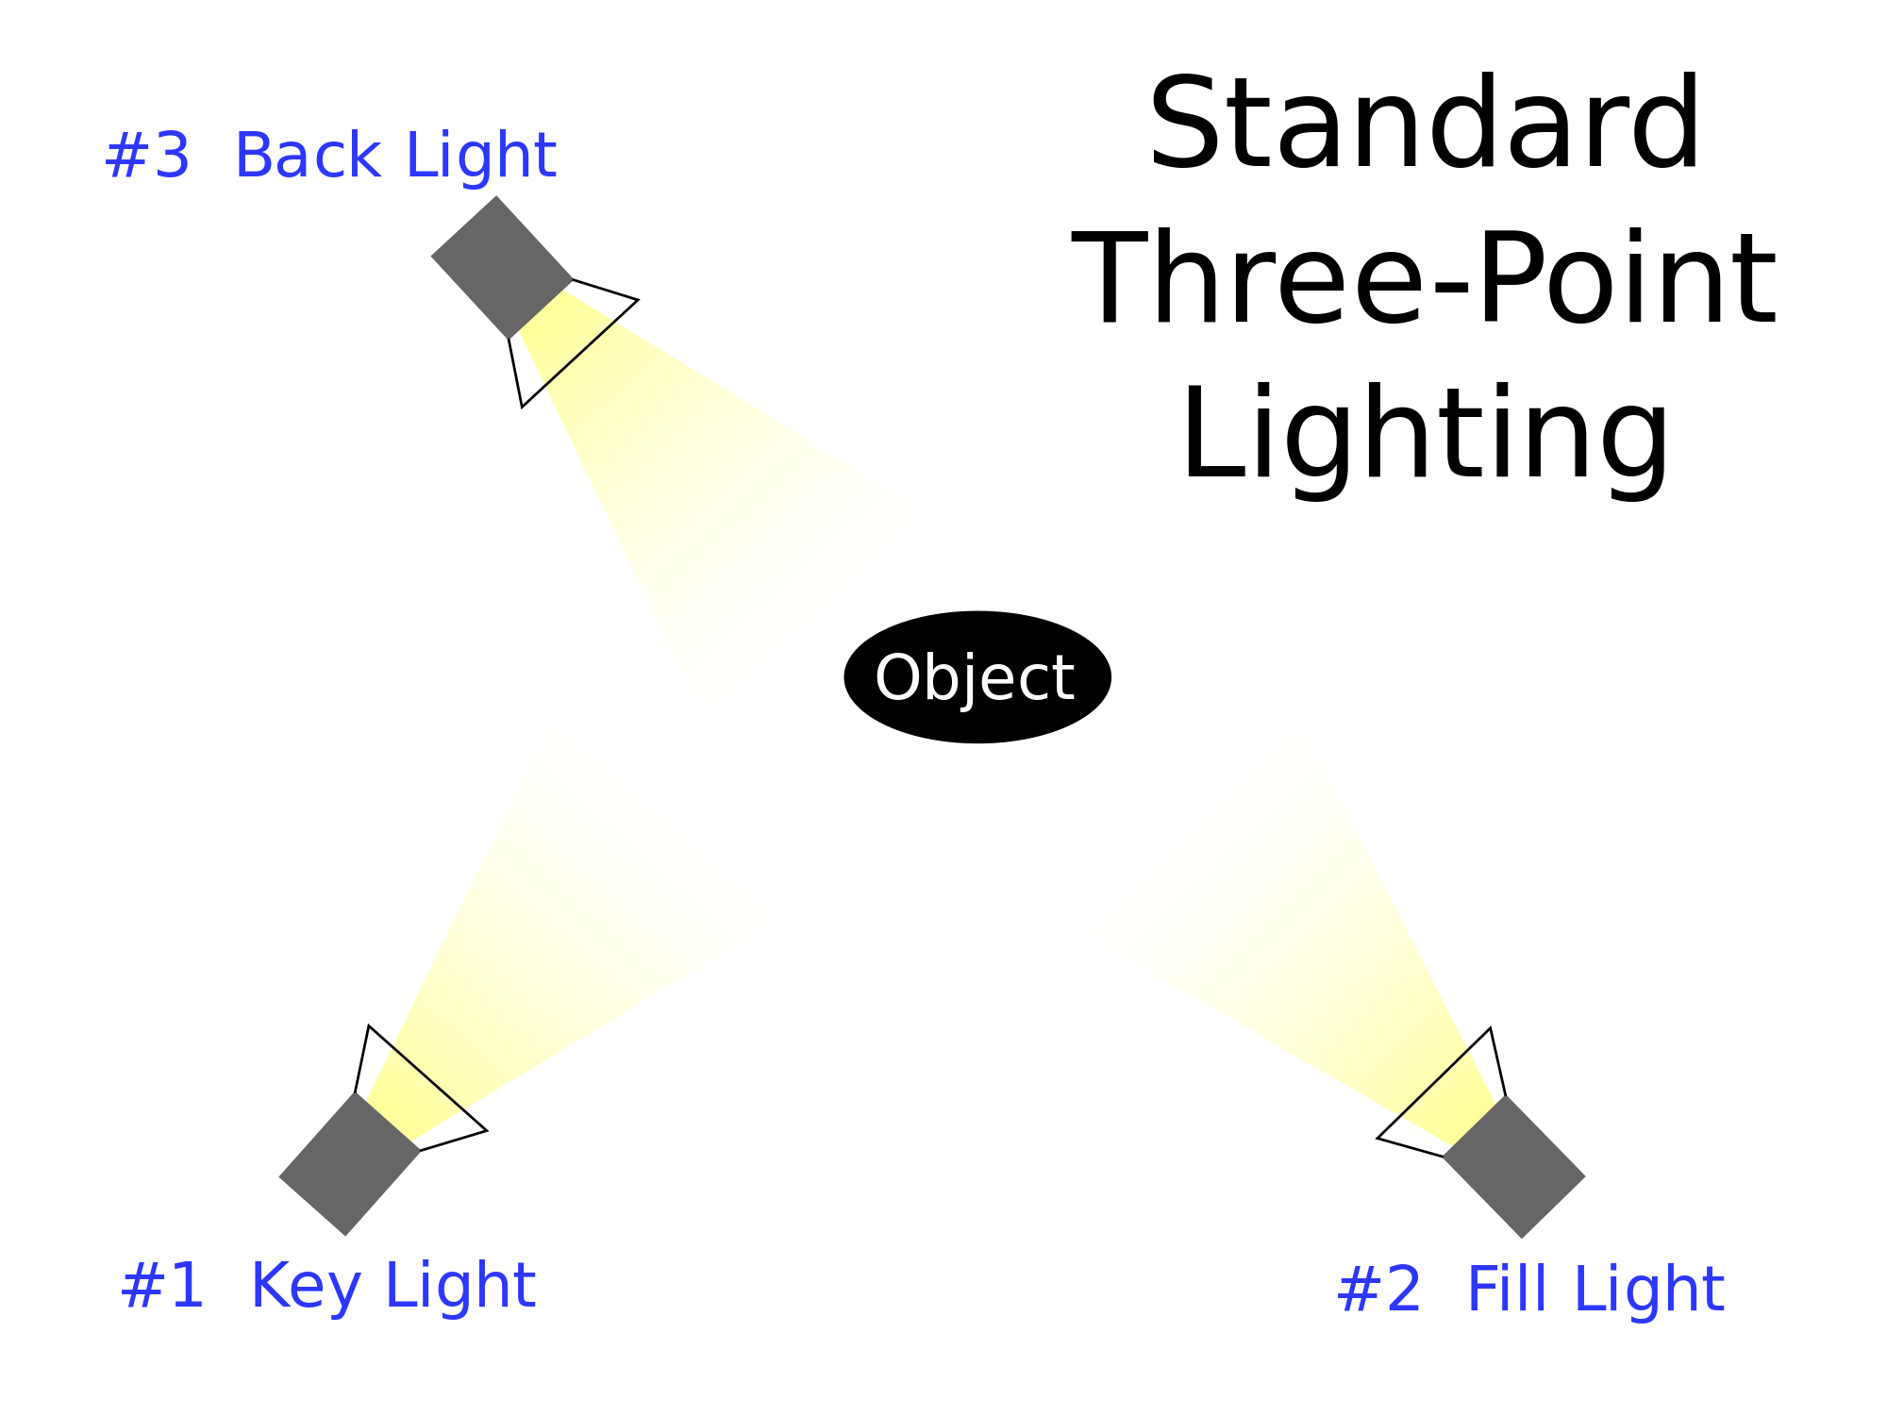
Advanced Lighting Terms
We call the typical lighting setup for filming and interviews, 3-point lighting. The 3-point lighting setup is made up of the Key Light, Fill Light and Back Light.

Slide 5
Advanced Lighting Terms
Key Light
The main source of light for the video production; pointed at the set to illuminate the subject(s). This is the first light you set up
Fill Light
Less intense light used to eliminate or soften the shadows. Should be set up 90 degrees from the Key Light (other side of subject). Move farther away from subject to make it less intense.
Back Light
Illuminates the subject(s) from behind; separates the subject(s) from the background itself. Creates a more dynamic image, set up last

Slide 6
Just Key Lights
Key Light and Fill Lights
Three Point Lighting Setups

Slide 7
Do you think cartoons and stop motion films use 3 point lighting?
True
False
Notes:
True or False
Use this template to do a quick check of students’ perceptions during your lesson.
🍐 This is a Pear Deck Multiple Choice Slide. Your current options are: A: True, B: False,
🍐 To edit the type of question or choices, go back to the "Ask Students a Question" in the Pear Deck sidebar.

Slide 8
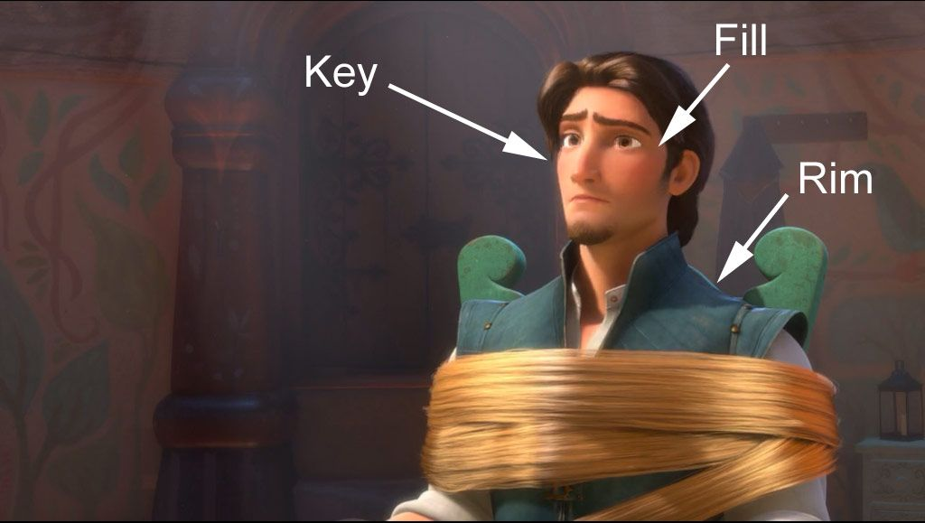
Even animators have to think about how lighting a scene when they are creating it digitally.
Back light

Slide 9
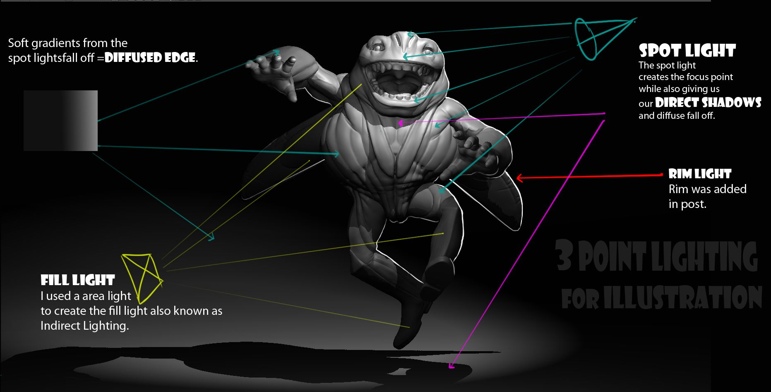
This would be the Key Light
This is another name for Back Light

Slide 10
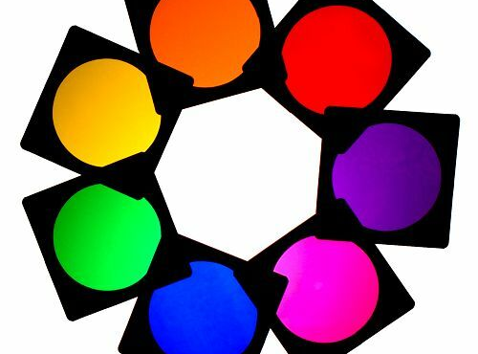
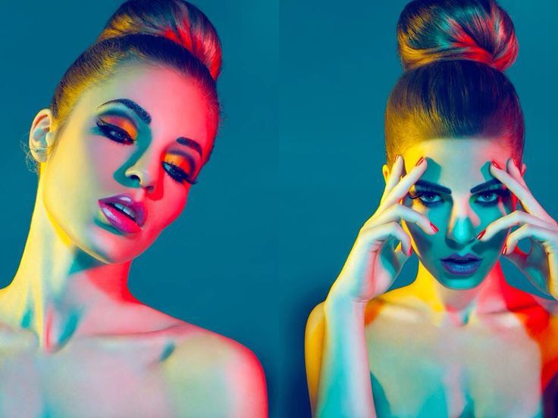
Gel - Lighting Equipment
Color gel is a transparent colored material that is used in theater, event production, photography, videography and cinematography to color light and for color correction

Slide 11
Color Temperature
Color temperature describes the “color” of white light by a light source radiated by a perfect black body at a given temperature measured in degrees Kelvin.
Meaning???
Light can be warm (yellow/orange) or cool (blue). Color temperature can even affect the tone of your story.

Slide 13
The next slide is a few shots from House Hunters. I show the original shot and then how I fixed it in the color correcting process
These issues stem from NOT white balancing or setting up proper lighting.

Slide 14
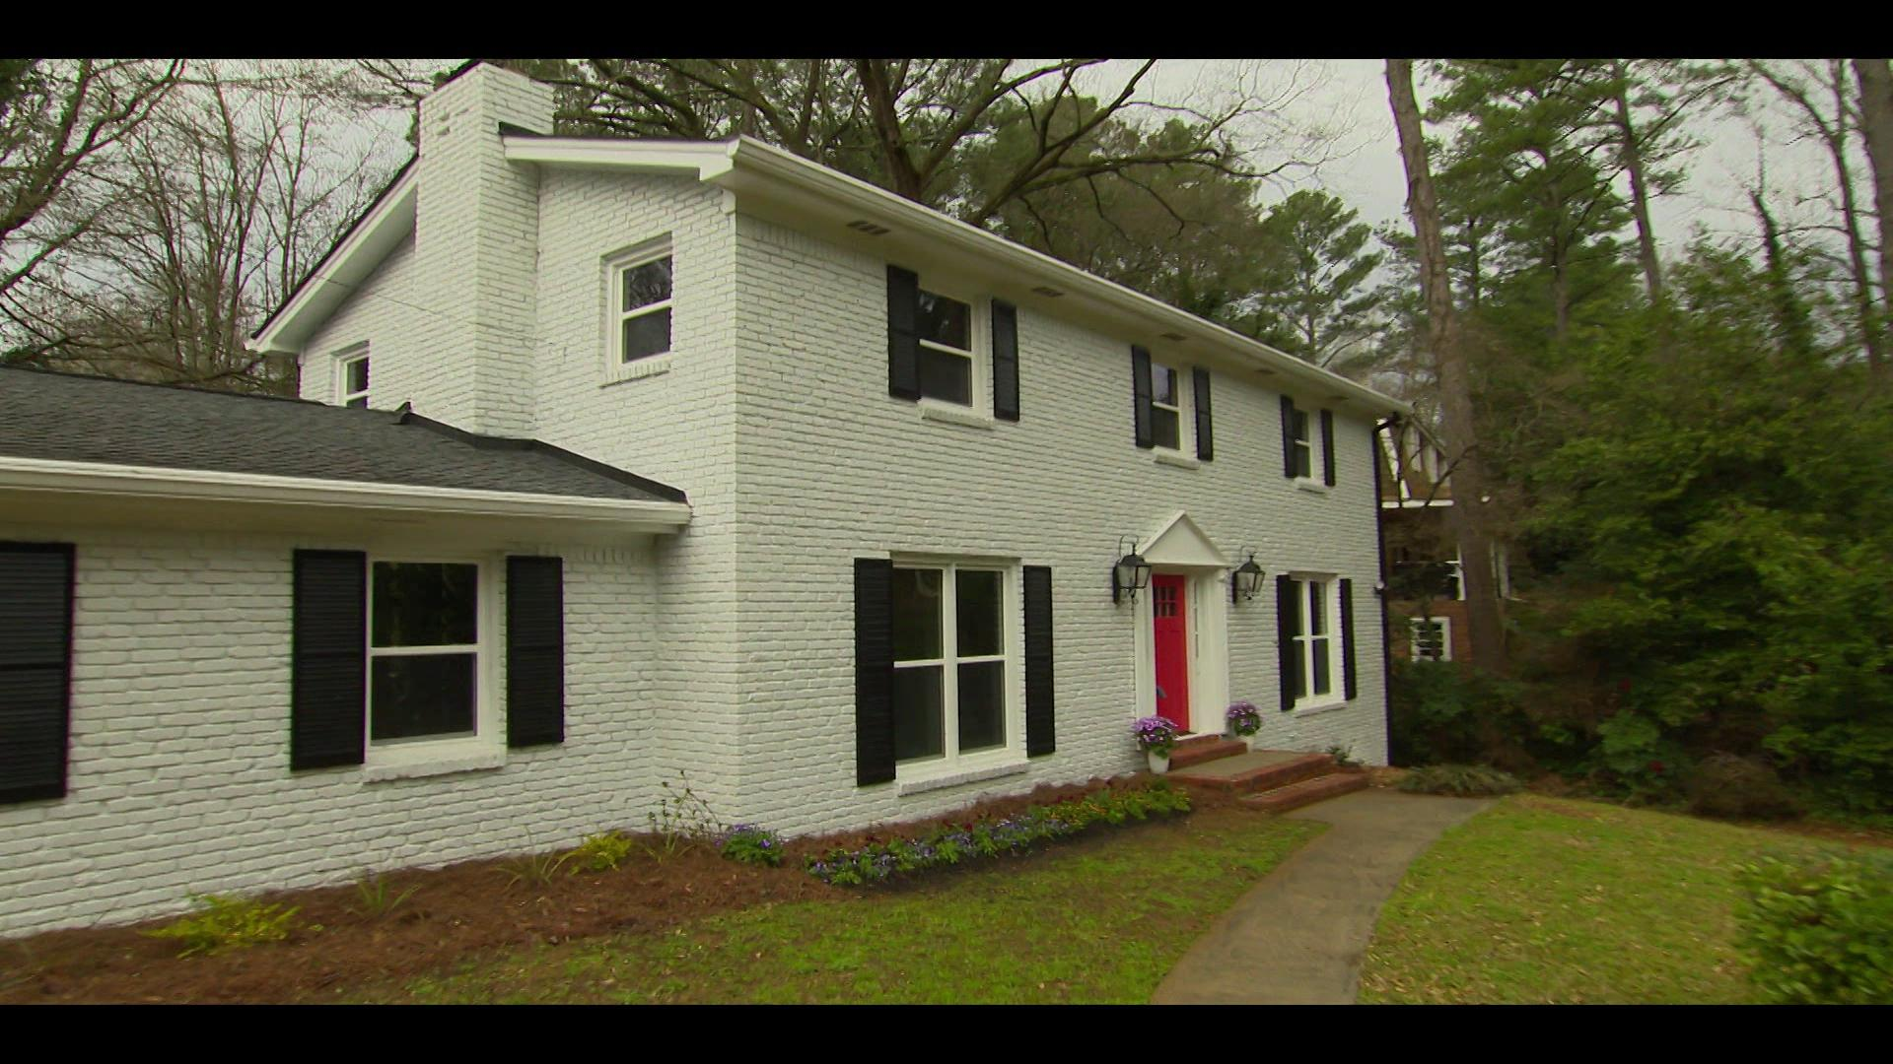

Slide 15
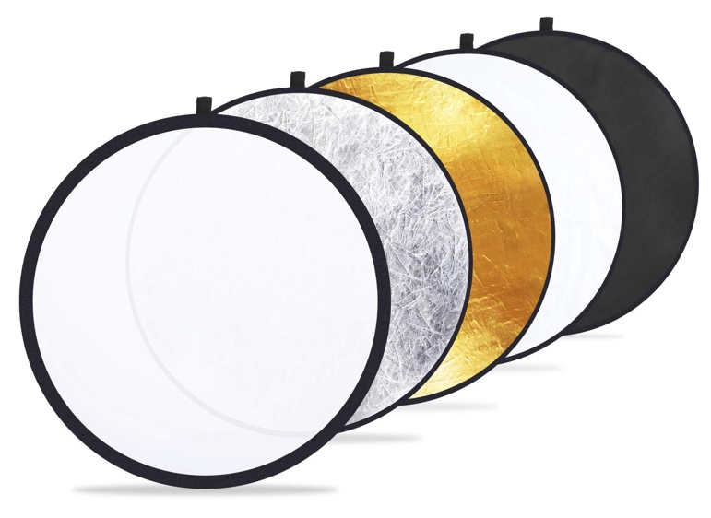
Reflector - Lighting Equipment
A photography light reflector bounces existing light. And re-directs it back onto the subject. Reflectors are excellent tools for adding fill light.

Slide 16
Umbrella - Lighting Equipment
Umbrellas produce indirect, bounced light; which produce a broader type of diffused lighting. Point an umbrella at a subject and voilà, you've got soft lighting!

Slide 17
Cables:

Slide 18
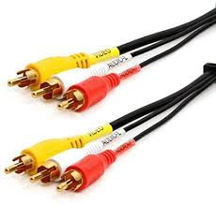
Composite (RCA) Cable
Common video & audio cable used by both consumers and professionals
Used for VCRs, DVD players, etc.
Color coded to distinguish between audio/video

Slide 19
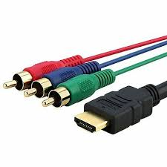
Component (RGB) Cable
Red, Blue, and Green color coded connectors
Carries high-def video signals only
Splits video signals into three parts for better detail and color accuracy

Slide 20
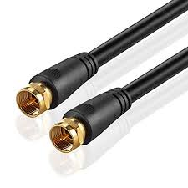
Coaxial (F) Cable
Commonly used to transmit video signal (cable TV, antenna)
Can span long distances without signal loss
Carries audio and video

Slide 21
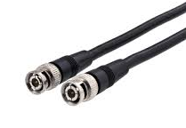
BNC Cable
Used in professional settings
Connects video camera to switcher (mixer)
Two-pin locking system to prevent it from being unplugged

Slide 22
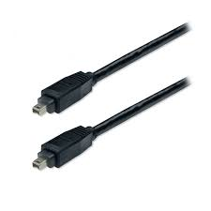
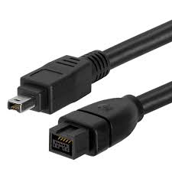
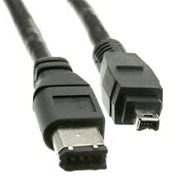
Firewire Cable
Has high transfer speed - used with computers
Captures audio or video from recording device into the computer
Different looks depending on age
4-pin
6-pin (400)
9-pin (800)

Slide 23
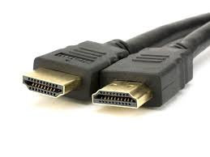
HDMI Cable
High-definition
Carries digital audio and video
Combines audio and video signals into one cable to simplify connection

Slide 24
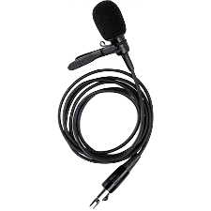
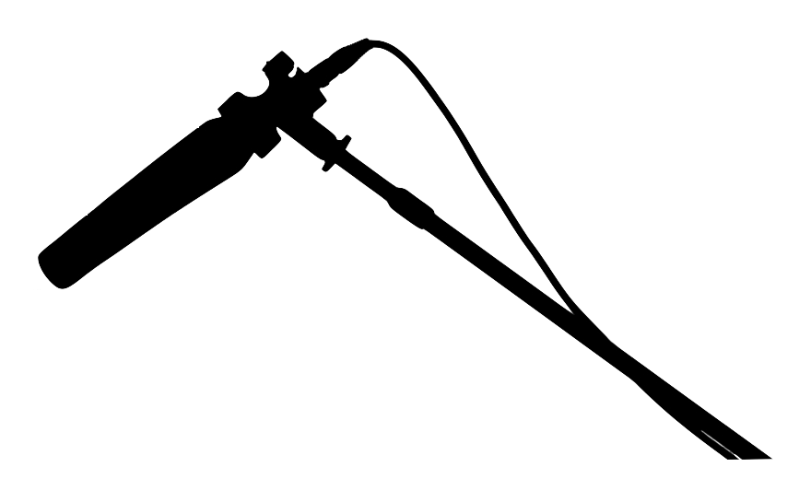
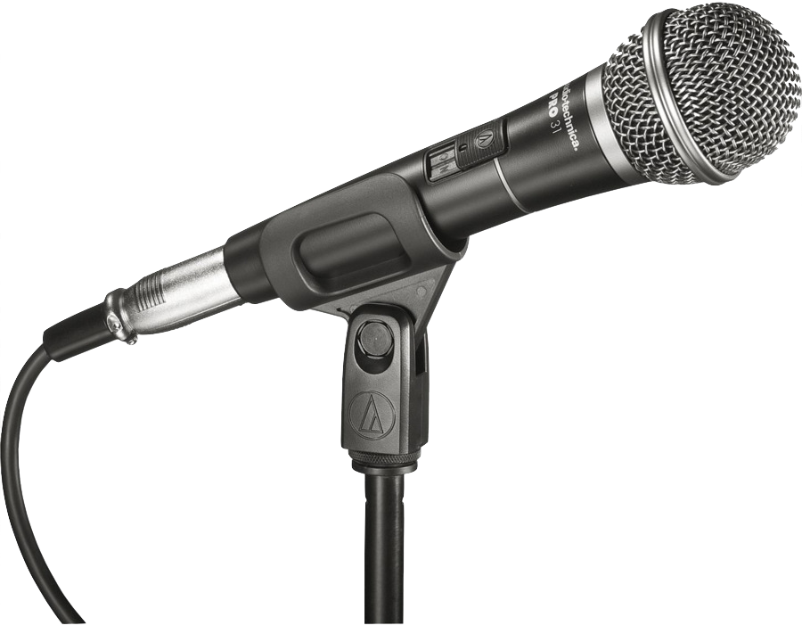
Microphones

Slide 25
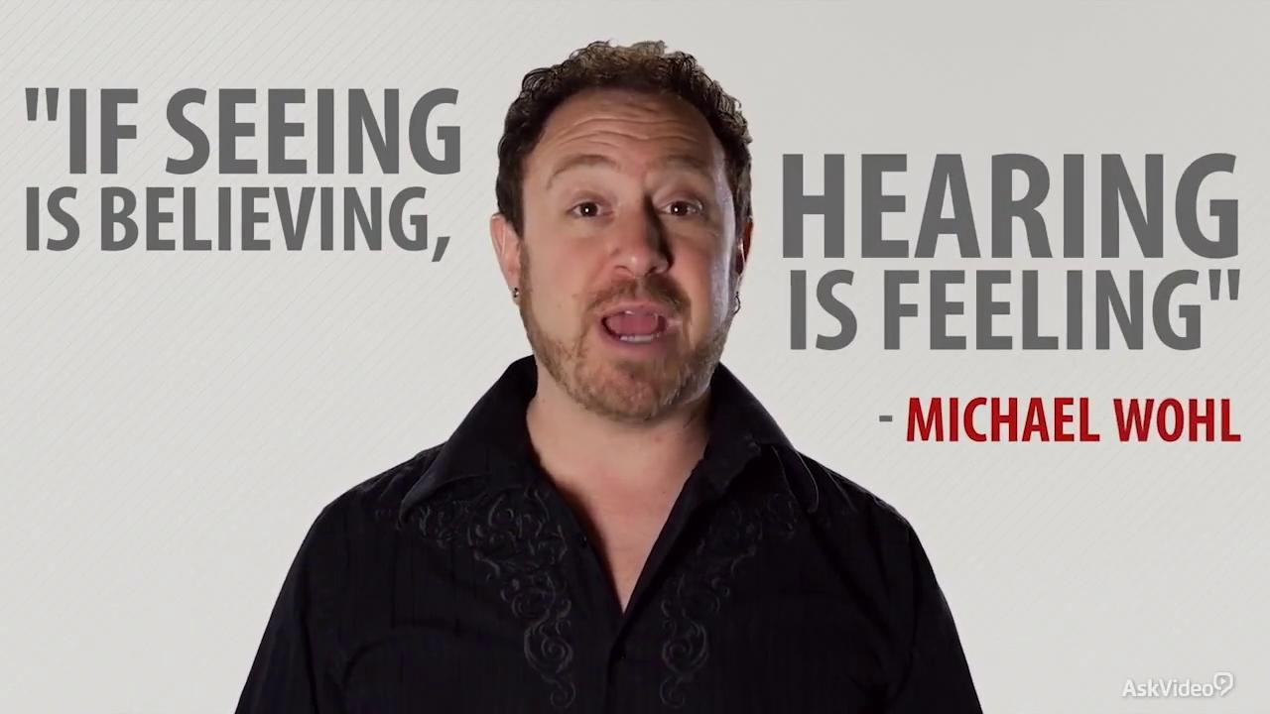

Slide 26
3 main Microphones to remember
Handheld Mic
Lavalier Mic
Shotgun Mic

Slide 27
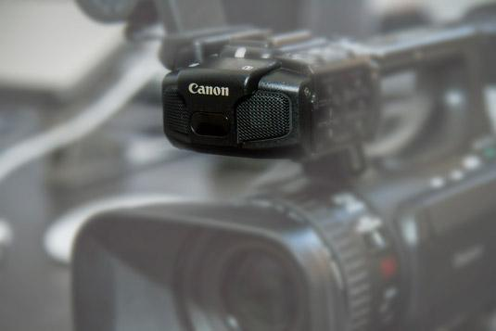
On Board Mic
Almost all cameras have some form of an on board mic.

Slide 28
Handheld Mic
Most used microphone
Designed to be held in the hand, but they can also be clipped onto a microphone stand.
Pick up sound directly from the mouth.
Can be wired or wireless
Wired mics are constricted to the length of the cord

Slide 29
Hand Held Mic
Perfect for:
Interviews
Speeches
Musical performances
News reporting
This microphone is useful for talking between two people and pointing it directly at their mouth.

Slide 30
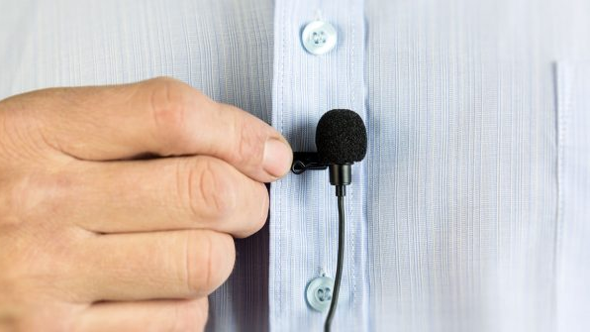
Lavalier mic
Also known as :
Lapel mic
Lav mic
Wireless mic
Clip-on mic

Slide 31
Lavalier mic
Perfect for:
Shooting from long distances
Interviews
Tours
News casters
Anytime the mic needs to be hidden

Slide 32
Lavalier Mic - Pros
Pinned to the subject’s outerwear
Conceal them so that viewers can’t see the mic
The smallest microphone
The only microphone someone does not have to hold
Only picks up sound from one direction

Slide 33
Lavalier Mic - Downside
Even though it allows the actor to be handsfree, this microphone is pinned to clothes and has to be close to the person’s mouth. Hair and clothing articles can muffle or rustle against this microphone causing unwanted or bad sound.

Slide 34
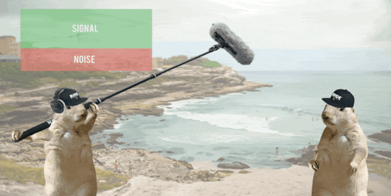
Shot Gun Mic
Perfect for:
Dialogue
Close-ups
Movie scenes
Also known as Boom Mic

Slide 35
Shot Gun Mic
Attached to the camera
If attached to a boom pole, becomes a boom mic
Has a narrow pick up pattern
Should be pointed directly at or close to the audio source

Slide 37
Shotgun & Boom mics
Boom mics and Shotgun mics are used the most because they can be held just off screen and still allow for good quality of sound.
They are the only mics that aren’t in front of the camera
But we have to be careful not to have it fall into the camera’s view (seen at the beginning of previous video), this happens all the time and you may catch them in your tv shows you are watching.

Slide 38
Room tone
You want to record 30 seconds of silence when filming because it allows you to place this audio under jumpcuts in the editing process. Allows us to smooth audio cuts or issues in editing.
You should always get 30 seconds before and after you film to use for editing
No room is ever completely silent. If you listen right now, your room probably has the humming of a light source or computer source. Or you can hear noises from outside your room.

Slide 39
Audio to Enhance Video
Natural Sound (AKA Nat Sound)
Using the actual sounds of the environment in which the video takes place.
Typically used to make the video seem more realistic.
Recorded Narration (Voiceover)
Dialogue added to a video production to explain the visual scenario and give the audience more information about what is happening in the video.

