Slide 1
Intro to Adobe Visual Design 1 (II41) Curriculum
CTE Summer Conference
Michael Poller and Emily Scales

Slide 2
Curriculum Team
Dennis Perks
Michael Poller
Emily Scales
Adobe Teacher
Apex Friendship High School
Apex, NC
National Board Certified with 22 years of experience in the classroom and at NCDPI and a Masters Degree.
Teaching next year:
Adobe Visual Design 1 H
Adobe Visual Design 2 H
Adobe Video Design
Adobe Teacher
Davie High School
Winston-Salem, NC
8 years experience. Adobe Subject Matter Expert for Certiport.
Teaching next year:
Adobe Visual Design 1 H
Adobe Visual Design 2H
Adobe Video Design H
Adobe Teacher
Wakefield High School
Raleigh, NC
National Board Certified with 15 years of experience.
Teaching next year:
Adobe Visual Design 1 H
Adobe Visual Design 2 H
Adobe Video Design
Adobe Digital Design
Advanced Studies

Slide 3
AVD 1 Focus
Adobe Visual Design 1 is considered a introduction course to graphic design with a focus on Adobe Photoshop and Illustrator. This course goal is to prepare students to pass the Certiport Adobe Certified Professional Certification Exams.

Slide 4
Softwares:
Adobe Photoshop
Adobe Illustrator:
Best for Raster/Bitmap Graphic Images
Resolution Dependent
Best for Vector Images
Great for scalable images

Slide 5
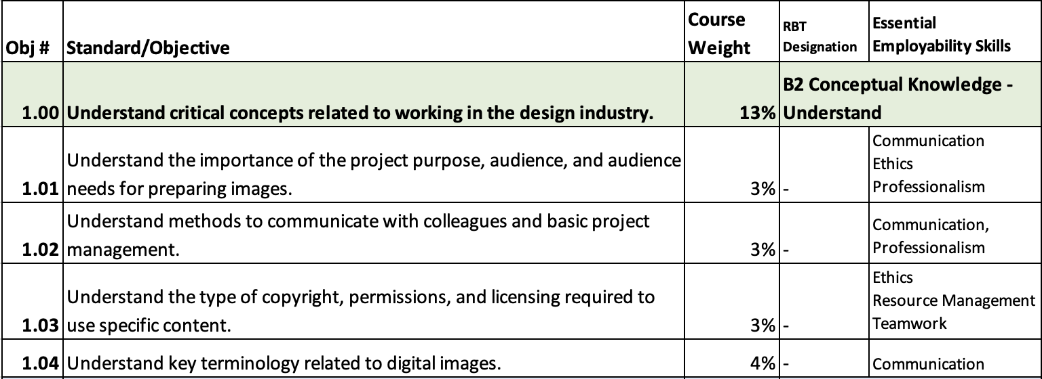
Blueprint and Standards

Slide 6
Blueprint and Standards

Slide 7
Blueprint and Standards

Slide 8
Blueprint and Standards

Slide 9
What is Provided in the Curriculum Guide?
The updated curriculum guide provides enough activities and information to take up at least an entire semester. It is up to you to decide what you want to use and work with. Below is a list of what is provided in the guide.
PowerPoints
Note Taking Guides
Vocabulary Glossaries
Vocabulary Based Worksheets
Software Based Worksheets
Step by Step Tutorials
Guided Practice Software Based Assignments
Independent Project Guides
Supplemental Resources

Slide 10
Preparing for Certification
We strongly recommend that you help prepare students using a combination of:
Skills based activities in the software
GMetrix Practice Tests (in training and testing mode)
Additional Certification based questions around vocabulary
The ACP exams are highly specific to the way the questions should be answered and ensure that the students have had enough time to practice in GMetrix is essential for success.
*Please note that the ACP is a professional level exam and not written for students

Slide 11
Proof of Learning
The Proof of Learning for II41 Adobe Visual Design I is comprised of the ACP (Adobe Certified Professional) Photoshop credential and the ACP (Adobe Certified Professional) Illustrator Exam, which may be administered at the local level during the course.

Slide 12
Curriculum
This curriculum guide for II41 Adobe Visual Design I, was developed to assist teachers in preparing students to meet the North Carolina State Board of Education’s guiding vision that “Every public-school student in North Carolina will be empowered to accept academic challenges, prepared to pursue their chosen path after graduating high school, and encouraged to become lifelong learners with the capacity to engage in a globally-collaborative society.”
The course, II41 Adobe Visual Design I, is based on Adobe Certified Professional credential standards, and focuses on graphic design and Adobe software to teach today’s generation of students. The content has been designed to give students foundational skills in graphic design with Adobe Software, which may lead to a future career in a high demand, highly skilled job market. The CTE Course Management System includes the course standards, information career pathway, and equipment list.

Slide 13
Disclaimer
This curriculum is not designed to be a step-by-step guide. It is intended to provide resources at a variety of levels, which can be used to support teachers and students of various skill levels. There are four main types of content: Adobe HelpX resources, specific skills worksheets with supporting videos, guided practice activities with flipped videos, and independent project guides.
This guide, by itself, is not a direct path to certification. It is recommended that teachers use this guide in conjunction with Certiport provided resources such as GMETRIX practice tests and other possible certification study guides. Skills addressed in this guide align to the Adobe Certified Professional objective domains.
Contributions of many individuals and from many written resources have collectively made this curriculum guide possible. The major authors: however, do not claim or guarantee that its contents will eliminate acts of malpractice or negligence. The responsibility to adhere to safety standards and best professional practices is the duty of the practitioners, teachers, students, and/or others who apply the contents of this document. This guide was developed with federal Career and Technical Education for the 21st Century Act (Perkins V) funds.

Slide 14
Canvas
Canvas shell is located in Canvas Commons
The Canvas shell is broken down by standard and indicator on the modules page.
Every PPT, note taking guide, worksheet, and project is broken down individually in each module.
All of the individual files are located in the files page.
All projects are inserted into the module as a file. You have the ability to create assignments using those files to your liking.
Projects can me modified to your liking.
Some files will link out to external sites (Scales Adobe Website) but most are all stored internally in the Canvas shell.

Slide 15
Resources
Adobe Education Exchange
Adobe Certified Professional Pearson Sponsored Products
GMetrix Skills Management System
WHS Digital Media Website (created by Emily Scales)

Slide 16
Questions and Answers
AVD 1

Slide 17
Other Sessions
Overview of Adobe Visual Design 2: Wednesday, July 20th at 9:30 am to 11:00 am
Intro to InDesign: Wednesday, July 20th at 1:30pm to 3:00pm
Intro to Photoshop: Thursday, July 21st at 8am to 9:30am
Intro to Illustrator: Thursday, July 21st at 8am to 9:30am

