Slide 1
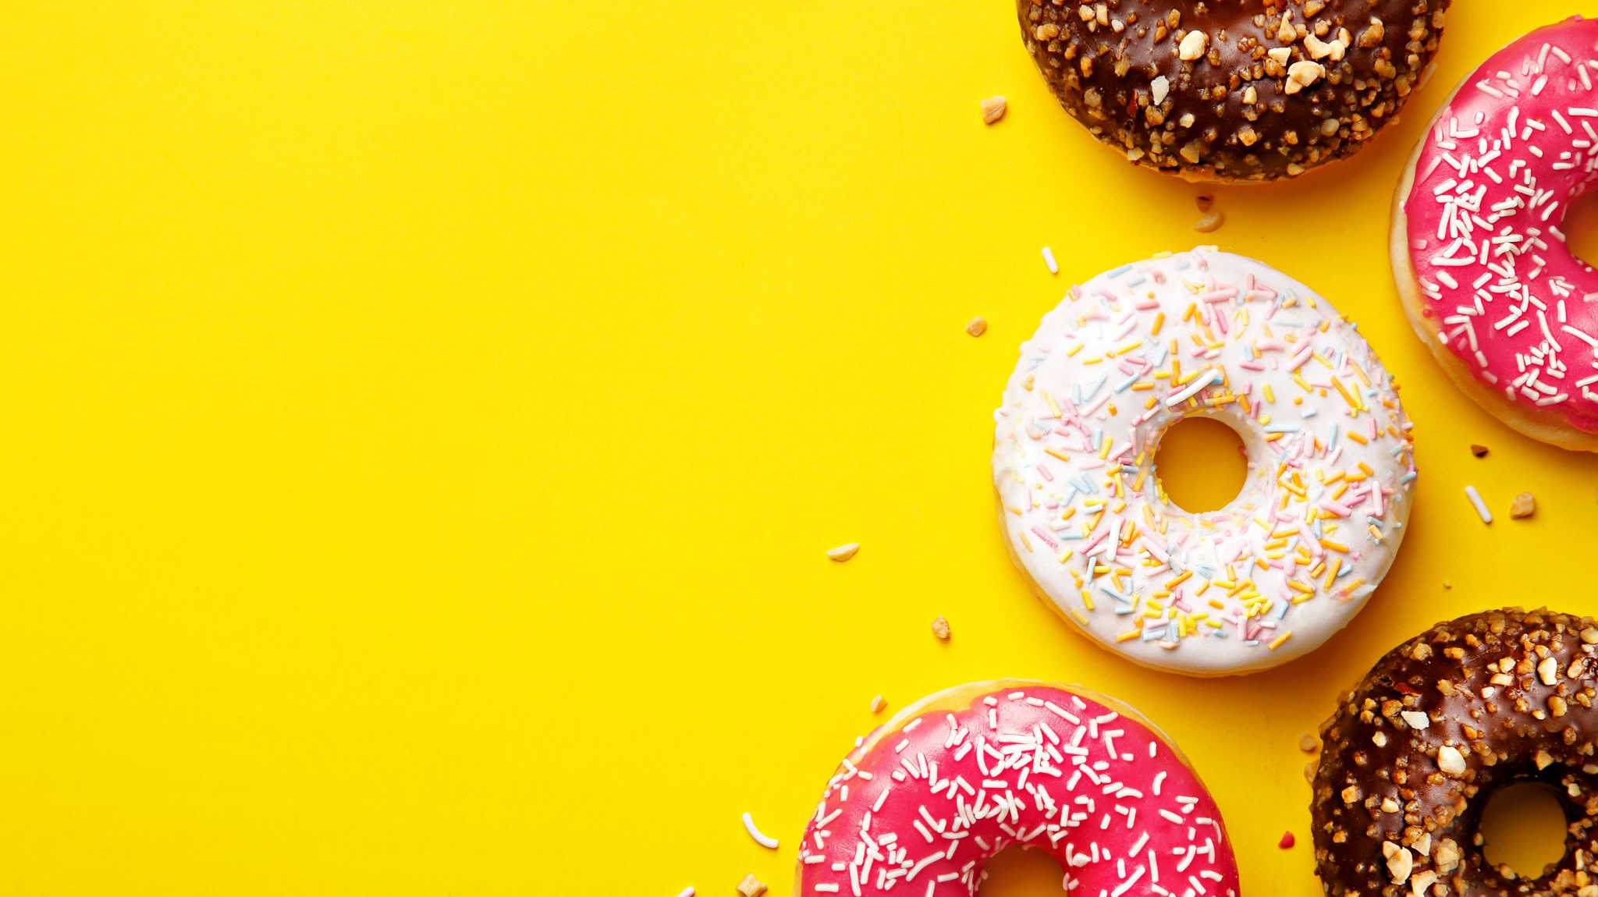
Understanding
COLOR
Terminology

Slide 2
RGB
RGB (red, green, and blue) refers to a system for representing the colors to be used on a computer display

Slide 3
If you remember any art class you have taken, then combining three primary colors, create additional second colors.
Our computer screen and cameras read everything as RGB colors, with Green replacing yellow as a primary color.

Slide 4
Contrast
Difference of color and brightness in an image

Slide 5
Contrast is adding or decreasing the shadows, which can help make certain areas of your image POP!

Slide 6
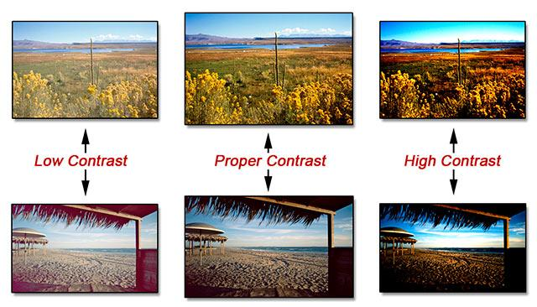

Slide 7
Overexposed and Crushed
An image that is brighter than it should be can be considered overexposed.
‘Crushing the blacks’ is the process of taking dark areas and making them even darker by increasing contrast in those areas.

Slide 8
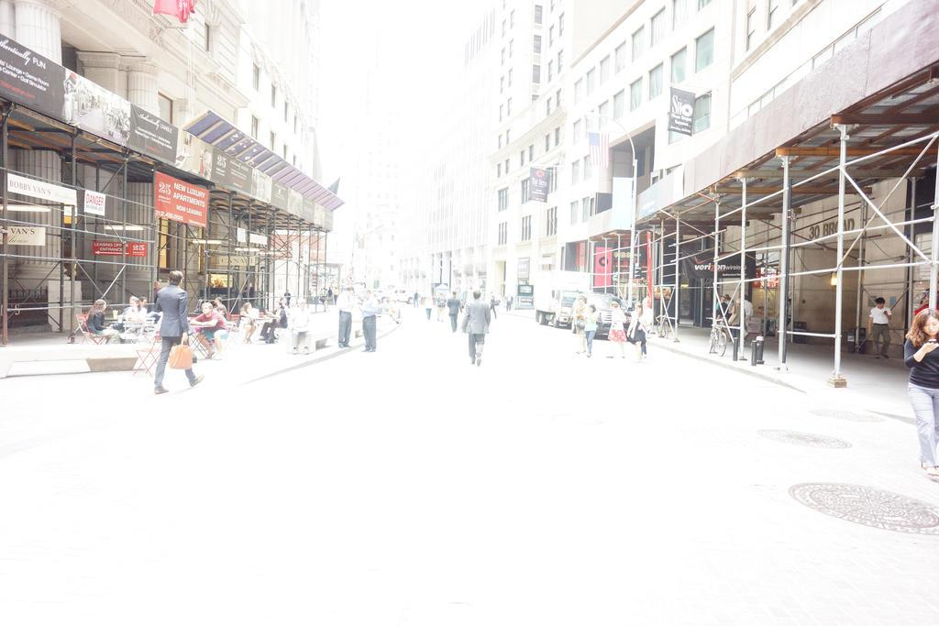
Overexposed

Slide 9
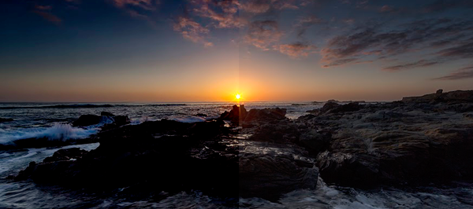
You can see that when we add TOO MUCH contrast, then we lose details in the darkest areas. We have added too much shadow and it become one dark blob of an area.

Slide 10
Hue
A color and shade of a color

Slide 11
You can see that with each other, there they are all yellow, red, blue, orange, green, etc, but they are slightly different. One might be lighter, another darker. These are types of Hues.

Slide 12
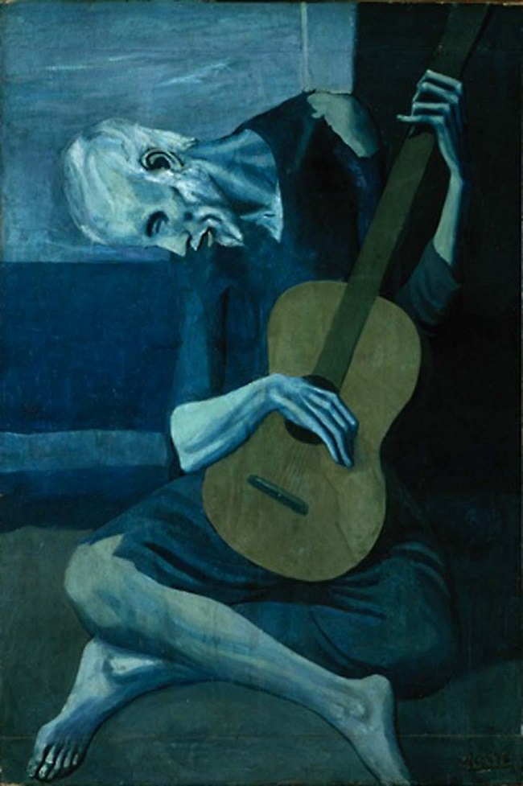
This image has a blue hue over the whole image.

Slide 13
Saturation
Intensity of color in an image

Slide 14
Intensifies more muted colors and leaves already intense colors the same
Vibrance
Notes:
Vibrance also prevents skin tones from becoming overly saturated and unnatural.

Slide 15
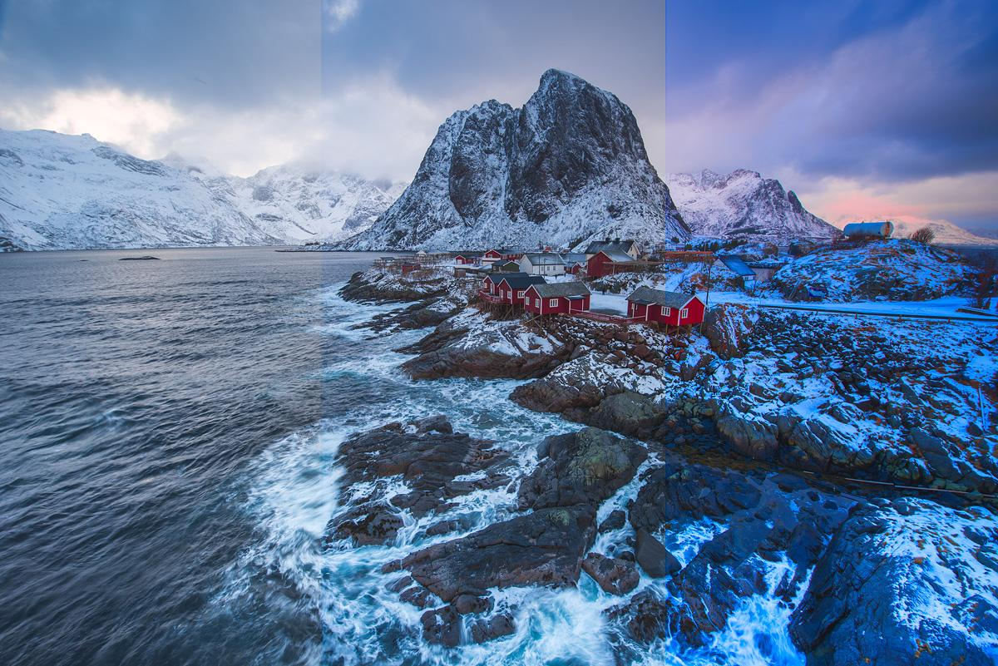
Original Photo
Vibrance Added
Saturation Added

Slide 16
Understanding the difference
Saturation
Vibrance
Intensifies the whole image. All colors are brightened and made to pop!
Intensifies only muted colors. So if there is a bright red barn and a dull road, Vibrance would leave the red barn alone and only brighten the dull road

Slide 18
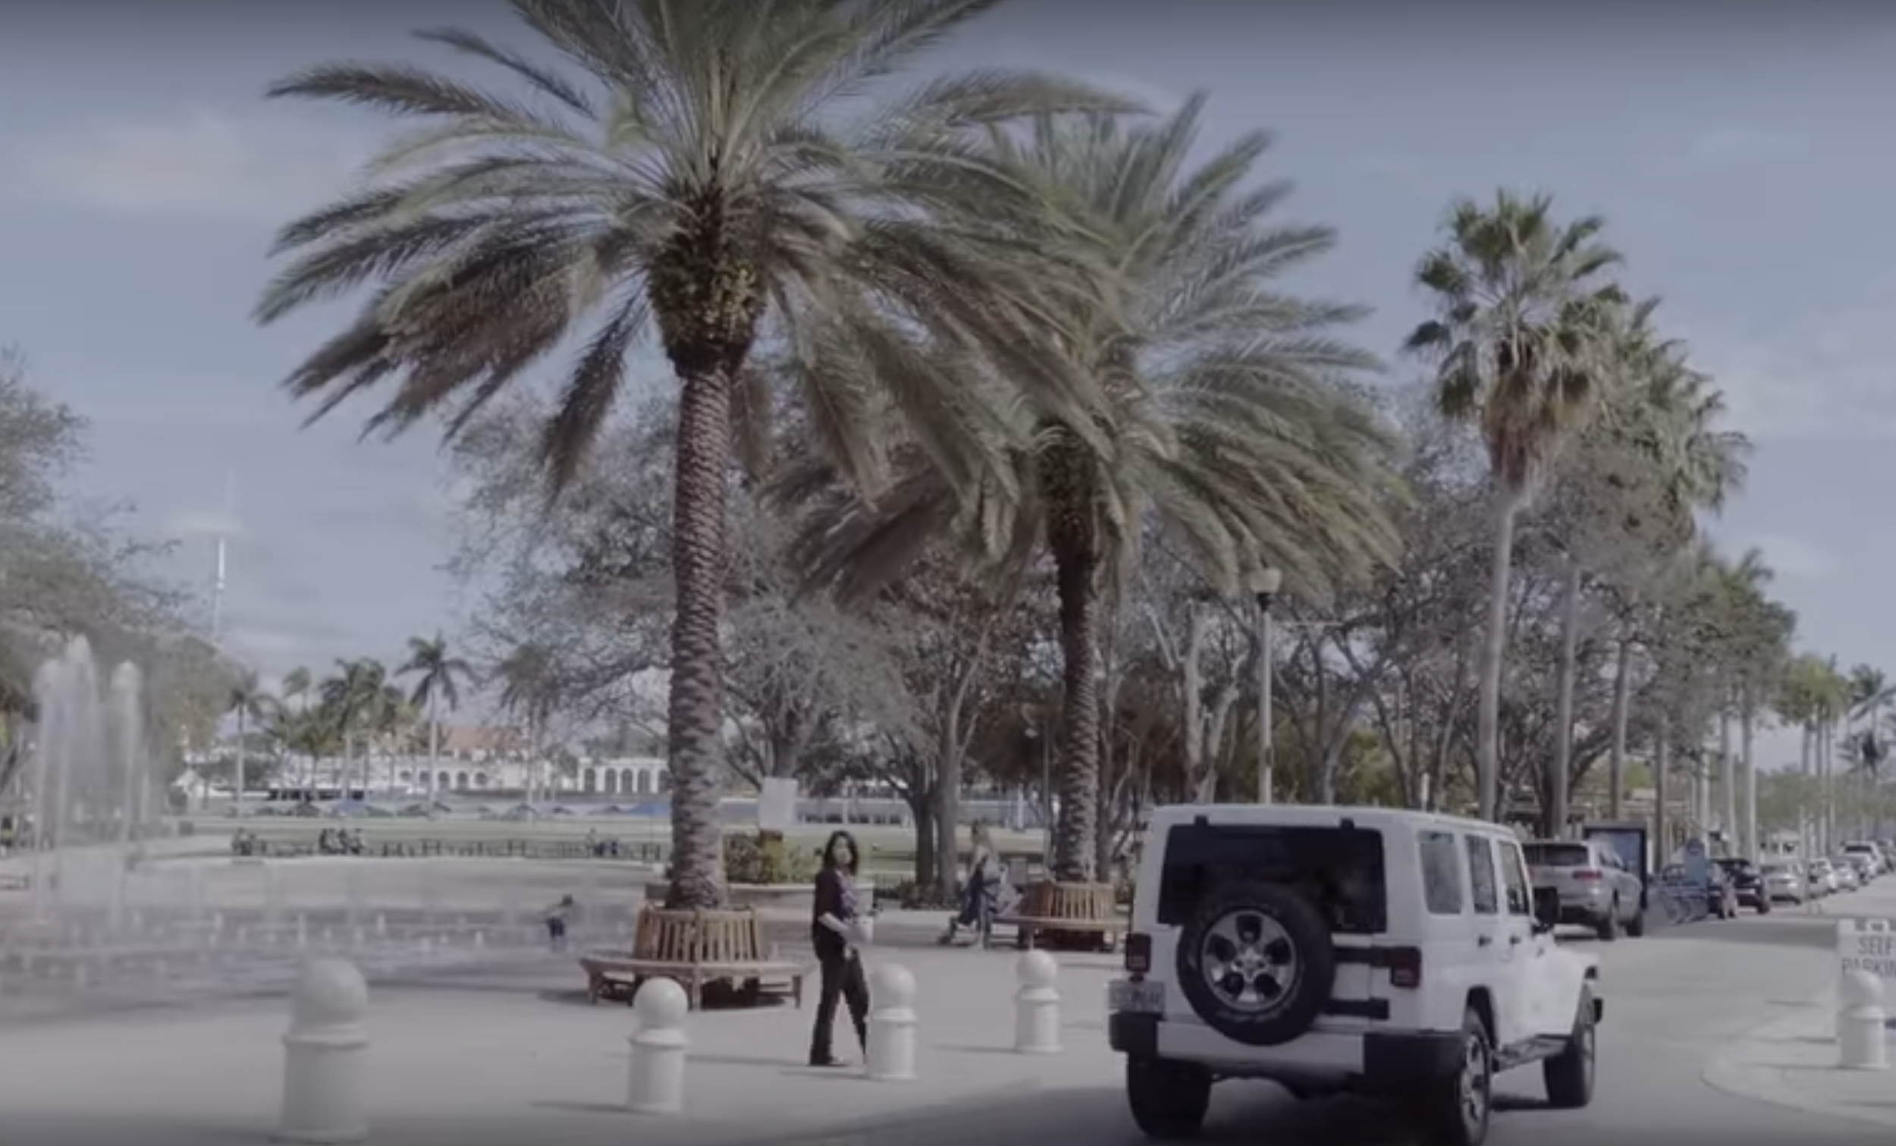
Can you tell what is wrong with this picture?

Slide 19
Does is seem dull? Not much color going on. Does is seem dark? Not very clear or bright.

Slide 20
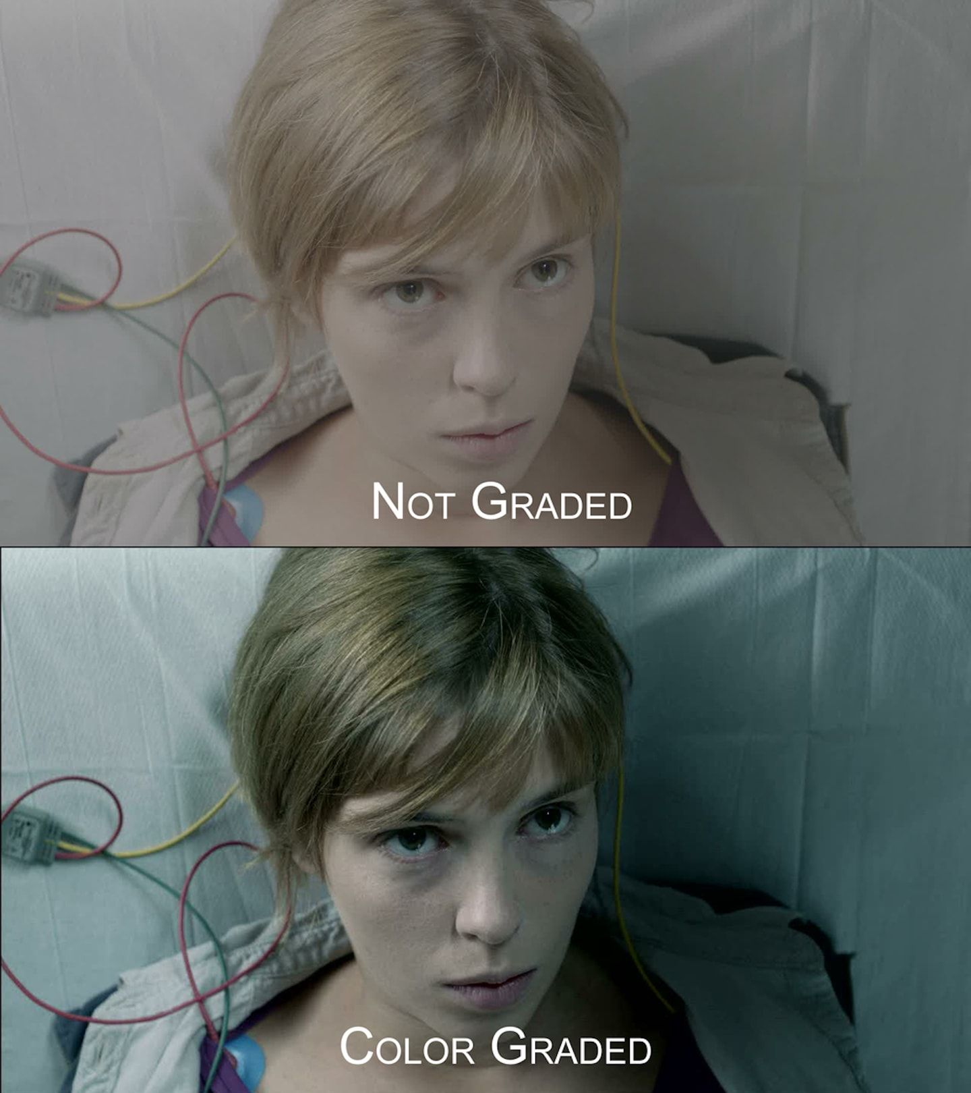
Color Grading
Is the process of improving the appearance of an image

Slide 21
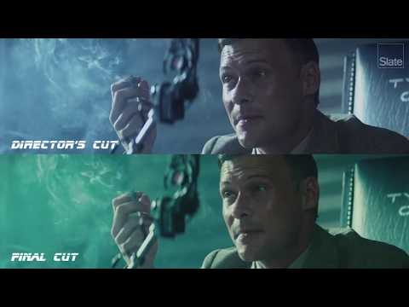
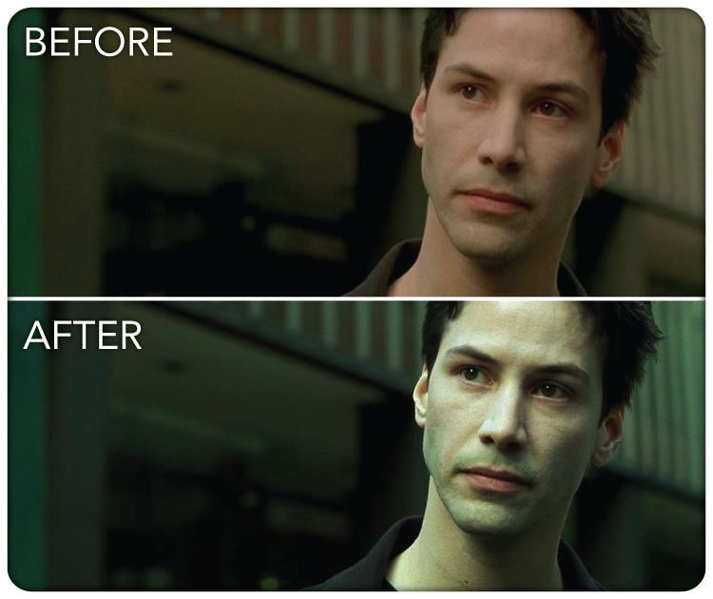
Sometimes Color grading is used to give the video a tone or feeling with color.

Slide 22
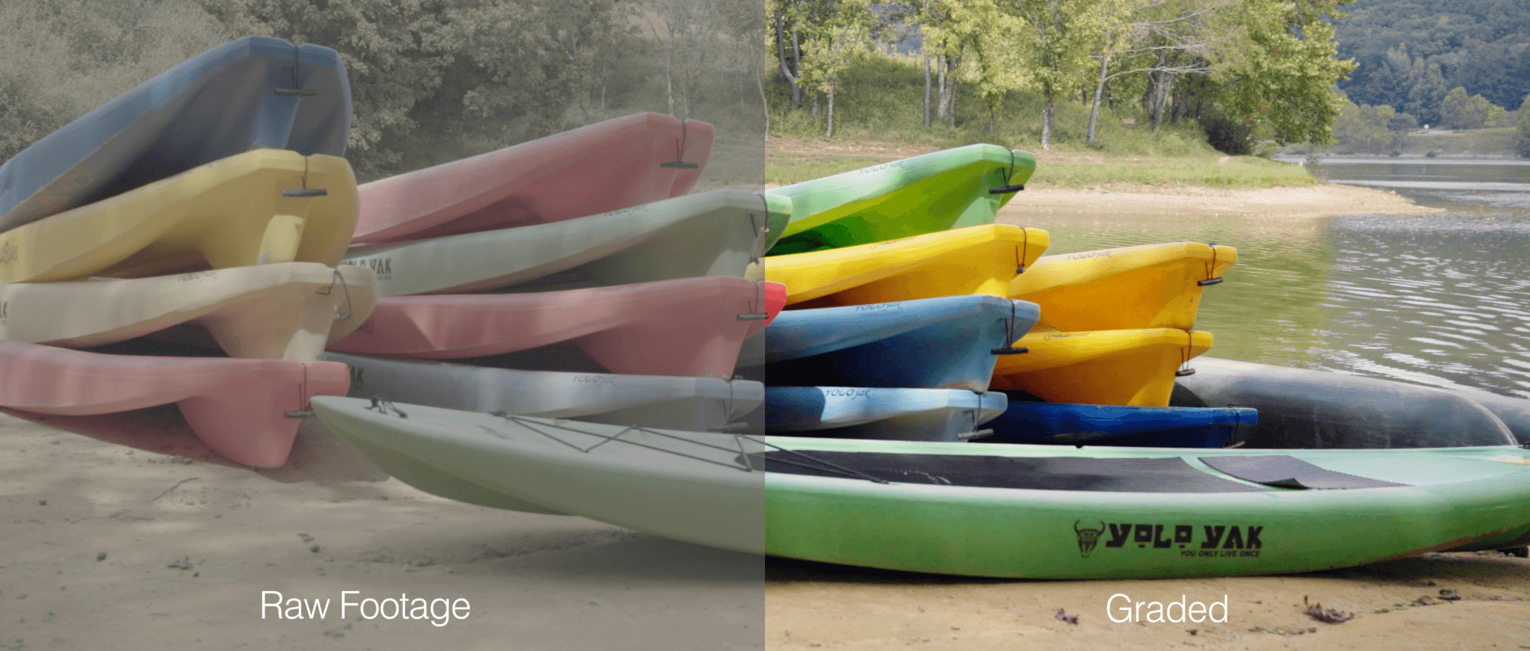
Raw Footage
(sometimes called “source footage”) is the crude, unprocessed camera footage that a videographer captures while shooting.

Slide 23
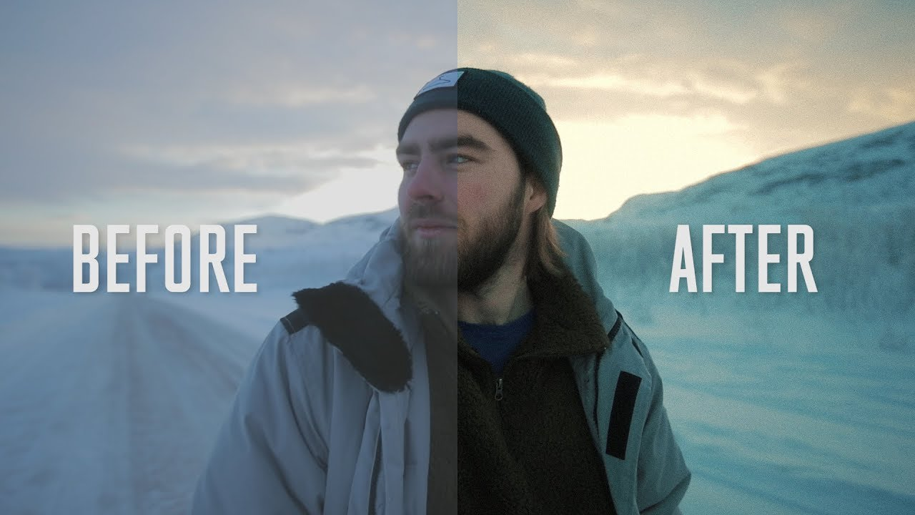

Slide 24
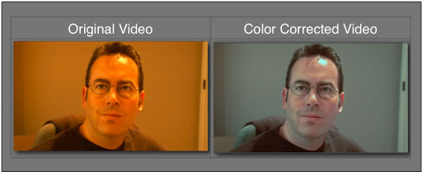
Color Correcting
correcting problems of the underlying image by balancing out the colors, making the whites appear white, the blacks appear black, and making sure that everything is even.

Slide 25
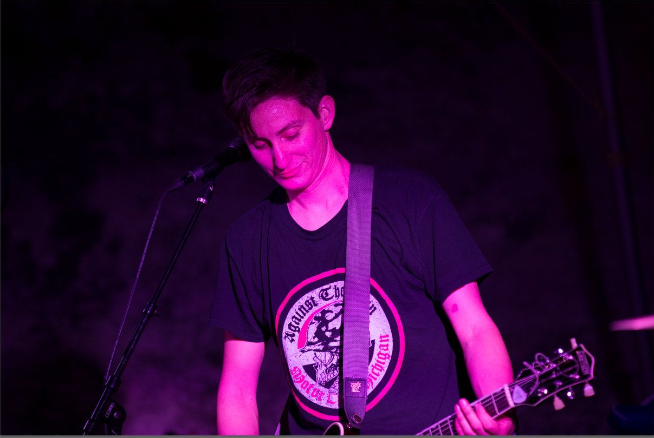
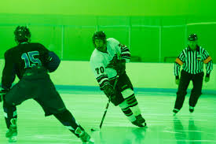
Think back to when we took a look at lighting
Natural light and overhead lighting can cause your camera to cast different types of color over your footage.

Slide 26
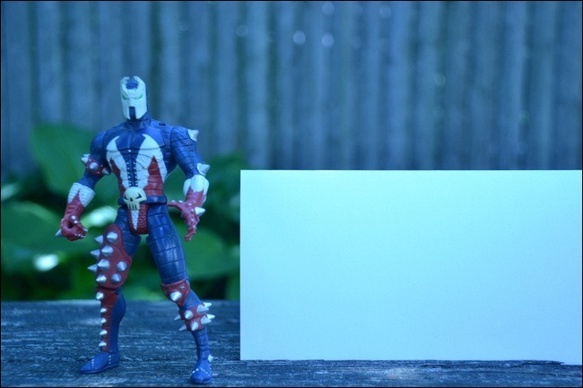
Take a look at this image, there is a blue color to this image. The paper in this shot, next to the figure, should be more white than it is.
Typically, we want to avoid having these issues when we start filming, but we can fix these issues in post.

Slide 27
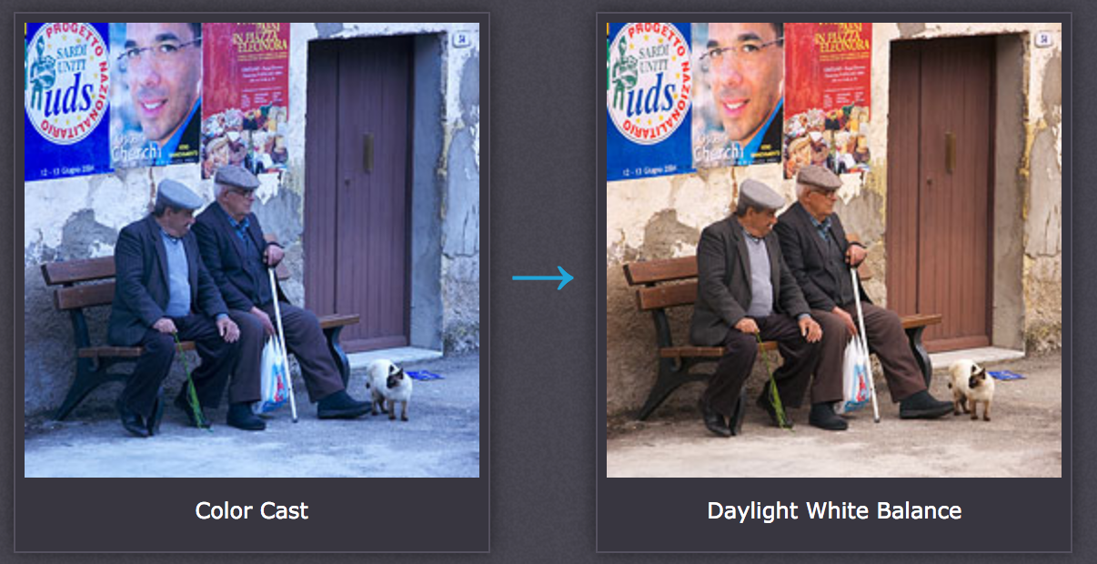
White Balance
the process correcting your footage, so that objects which appear white in person are rendered white in your video.

Slide 28
The easiest way to color correct is to use the White Balance eyedropper tool.
You will want to click on the eye dropper and then select an area in your footage that you think is white or the closest to white. This automatically changes your image.

Slide 30
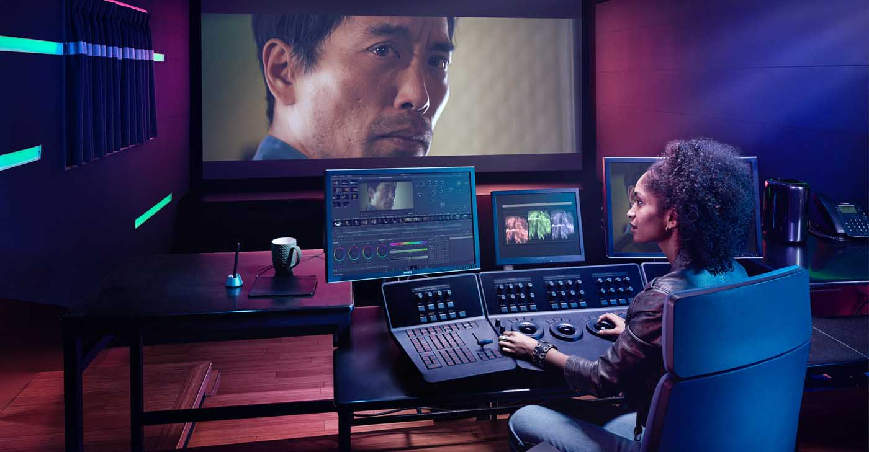
Almost all editing softwares have the capabilities for color grading & color correcting
This is what a colorist’s studio looks like. Mine was similar in Los Angeles.

Slide 31
Moving into Premiere Pro and the Color Workspace

Slide 32
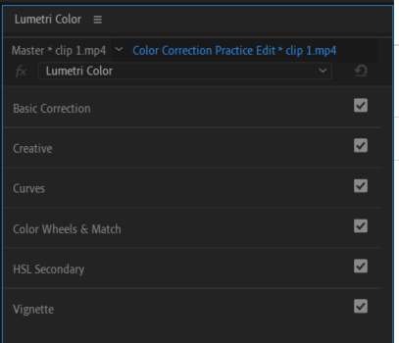
Color Workspace
Inside Premiere Pro, using the Lumetri Color workspace, you have many tools to help color grade and color correct.
Each menu has multiple options to choose from.
These panels allow you to manipulate multiple parts of your image.

Slide 33
The 4 menus we will use

Slide 34
With the coloring software, it breaks up your images into Shadows (your dark areas), Midtones (this is your middle color areas) and Highlights (which is the brightest areas in your image)
You can affect the brightness, the actual color, and so much more

Slide 35
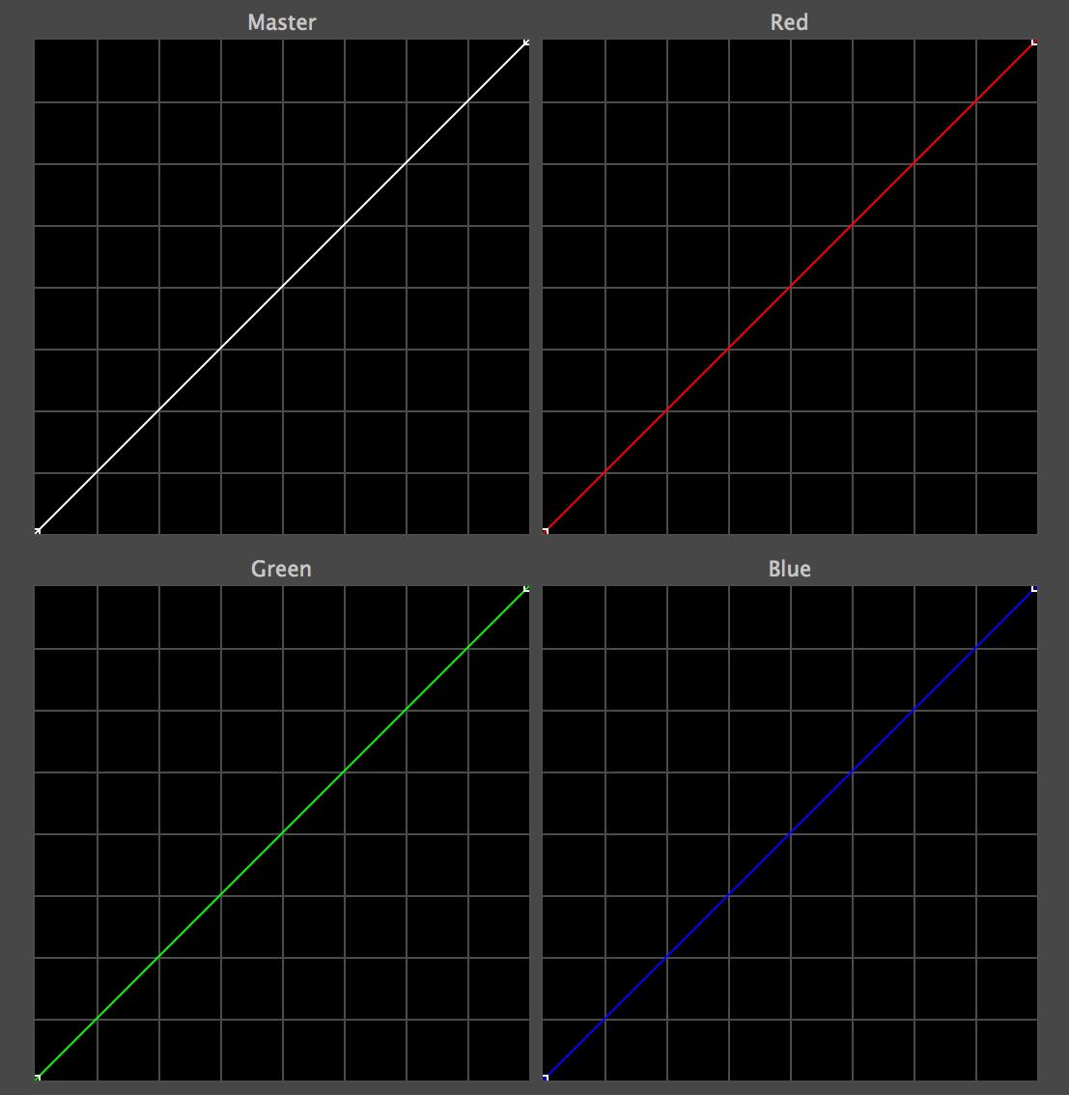
In Premiere, you also have tools called Curve lines.
Midtone
Highlights
Shadows
The curves tool allows you to make precise color and brightness adjustments to a video image.

Slide 36
Creative Look
We talked about how Colorists can give a look or feel to their video. One of your certification questions is to change the creative look of an image. this can be found in the Creative Panel and clicking on the look drop down menu.

